Slide 1
Main Figures

Slide 2
Figure 1: Field collections and experimental design. Non-bleached and bleached corals were collected from a reef in Mo’orea, French Polynesia immediately following a bleaching event. A) Picture of the LTER1 fore reef in Mo’orea, French Polynesia representative of the status of the reef where both bleached and non-bleached corals were present. A.I-A.V) depict the experimental design and sampling from corl nubbin collection (A.I), 7 day pretreatment in flow through aquaria (A.II), DOM exudation (A.III), 36 hour dark bottle incubation (A.IV), and sampling (A.V). B) Mean seawater temperatures over the period from January 1st 2018 until December 31st 2019 from 3 fore reef LTER sites. The Mo'orea Coral Reef Long Term Ecological Research (MCR LTER) daily average water temperature data time series was combined from 3 sites on the MCR LTER fore reef: FOR1, FOR4 and FOR5 (GPS location: 17°28'30.0"S 149°50'13.2"W; 17°32'49.2"S 149°46'08.4"W; 17°34'55.2"S 149°52'30.0"W; respectively). From each location data from five sensors (“upper water column”, “middle water column”, “bottom water column”, “temperature shallow”, and “temperature deeper”) was used to calculate the average temperature +/- 1 standard deviation. Standard deviation depicted in blue. The orange line indicates the thermal stress accumulation threshold level of 29°C. Bleaching was first observed in April 2019, indicated by the start of the red line, which continued until the temperature levels dropped under the thermal stress accumulation threshold. The experiment, indicated by the purple block, was started immediately after temperatures dipped below the thermal stress accumulation threshold. A subset of collected nubbins were sacrificed after the three day acclimatization period for symbiont cell concentration analysis to validate the observed bleaching status at collection (C). Healthy corals had significantly higher symbiont levels compared to bleached corals (two-way ANOVA, F=45.552, p=2.67e-08). After 7 days in the aquaria the 4 coral treatments had varying degrees of bleaching/paling with healthy at ambient temperatures having the highest concentrations, although these differences were not statistically significant (one-way ANOVA, F=2.623, p=0.123) (D). Microbial communities responded to DOM amendments by growing to significantly higher concentrations after incubating for 24 hours (one-way ANOVA, F=54.09, p=2.3e-08).

Slide 3
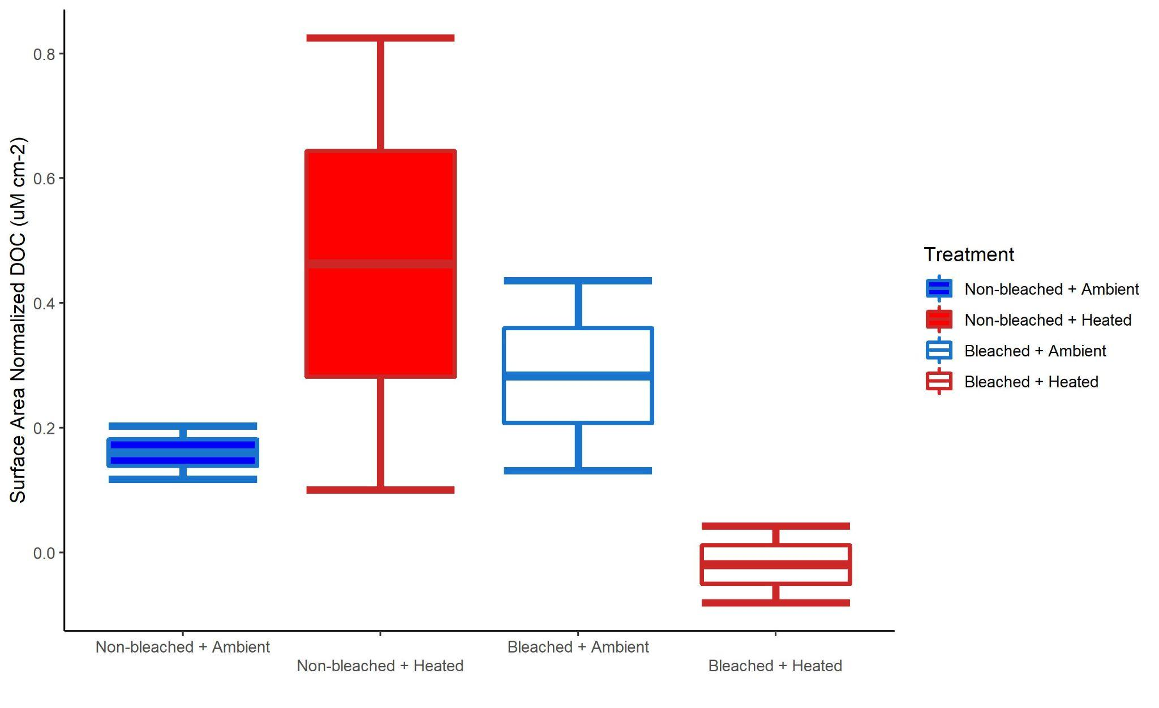
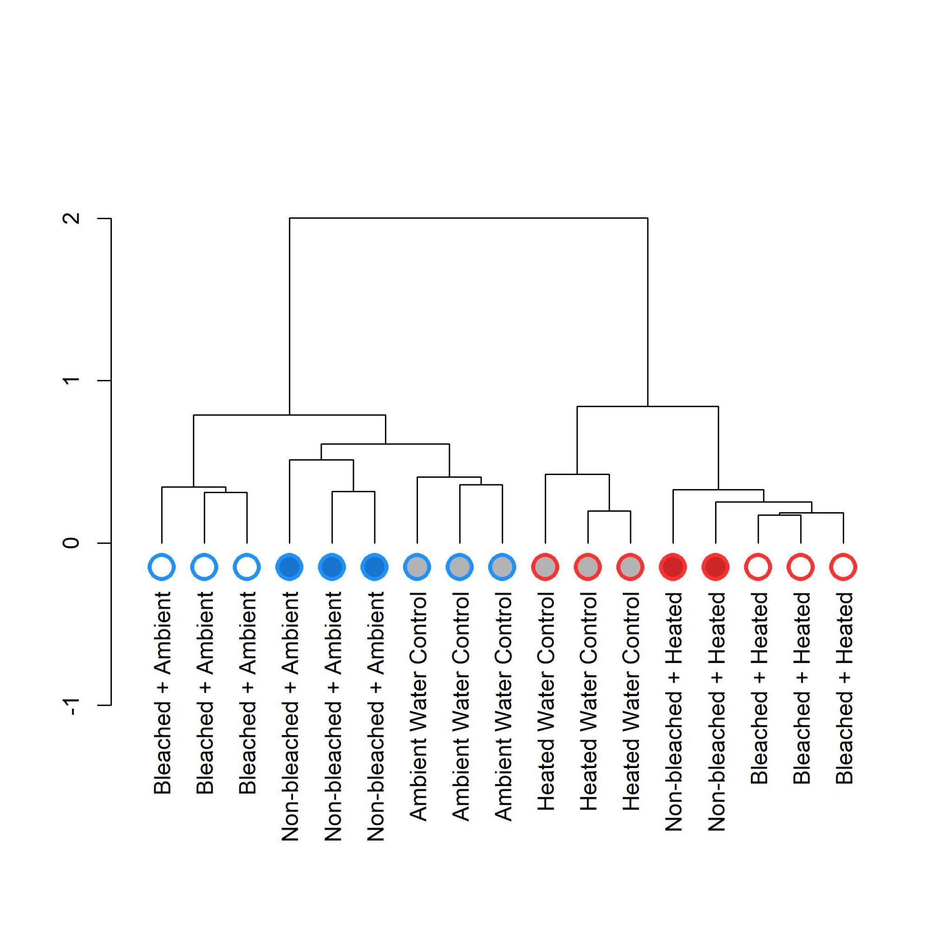
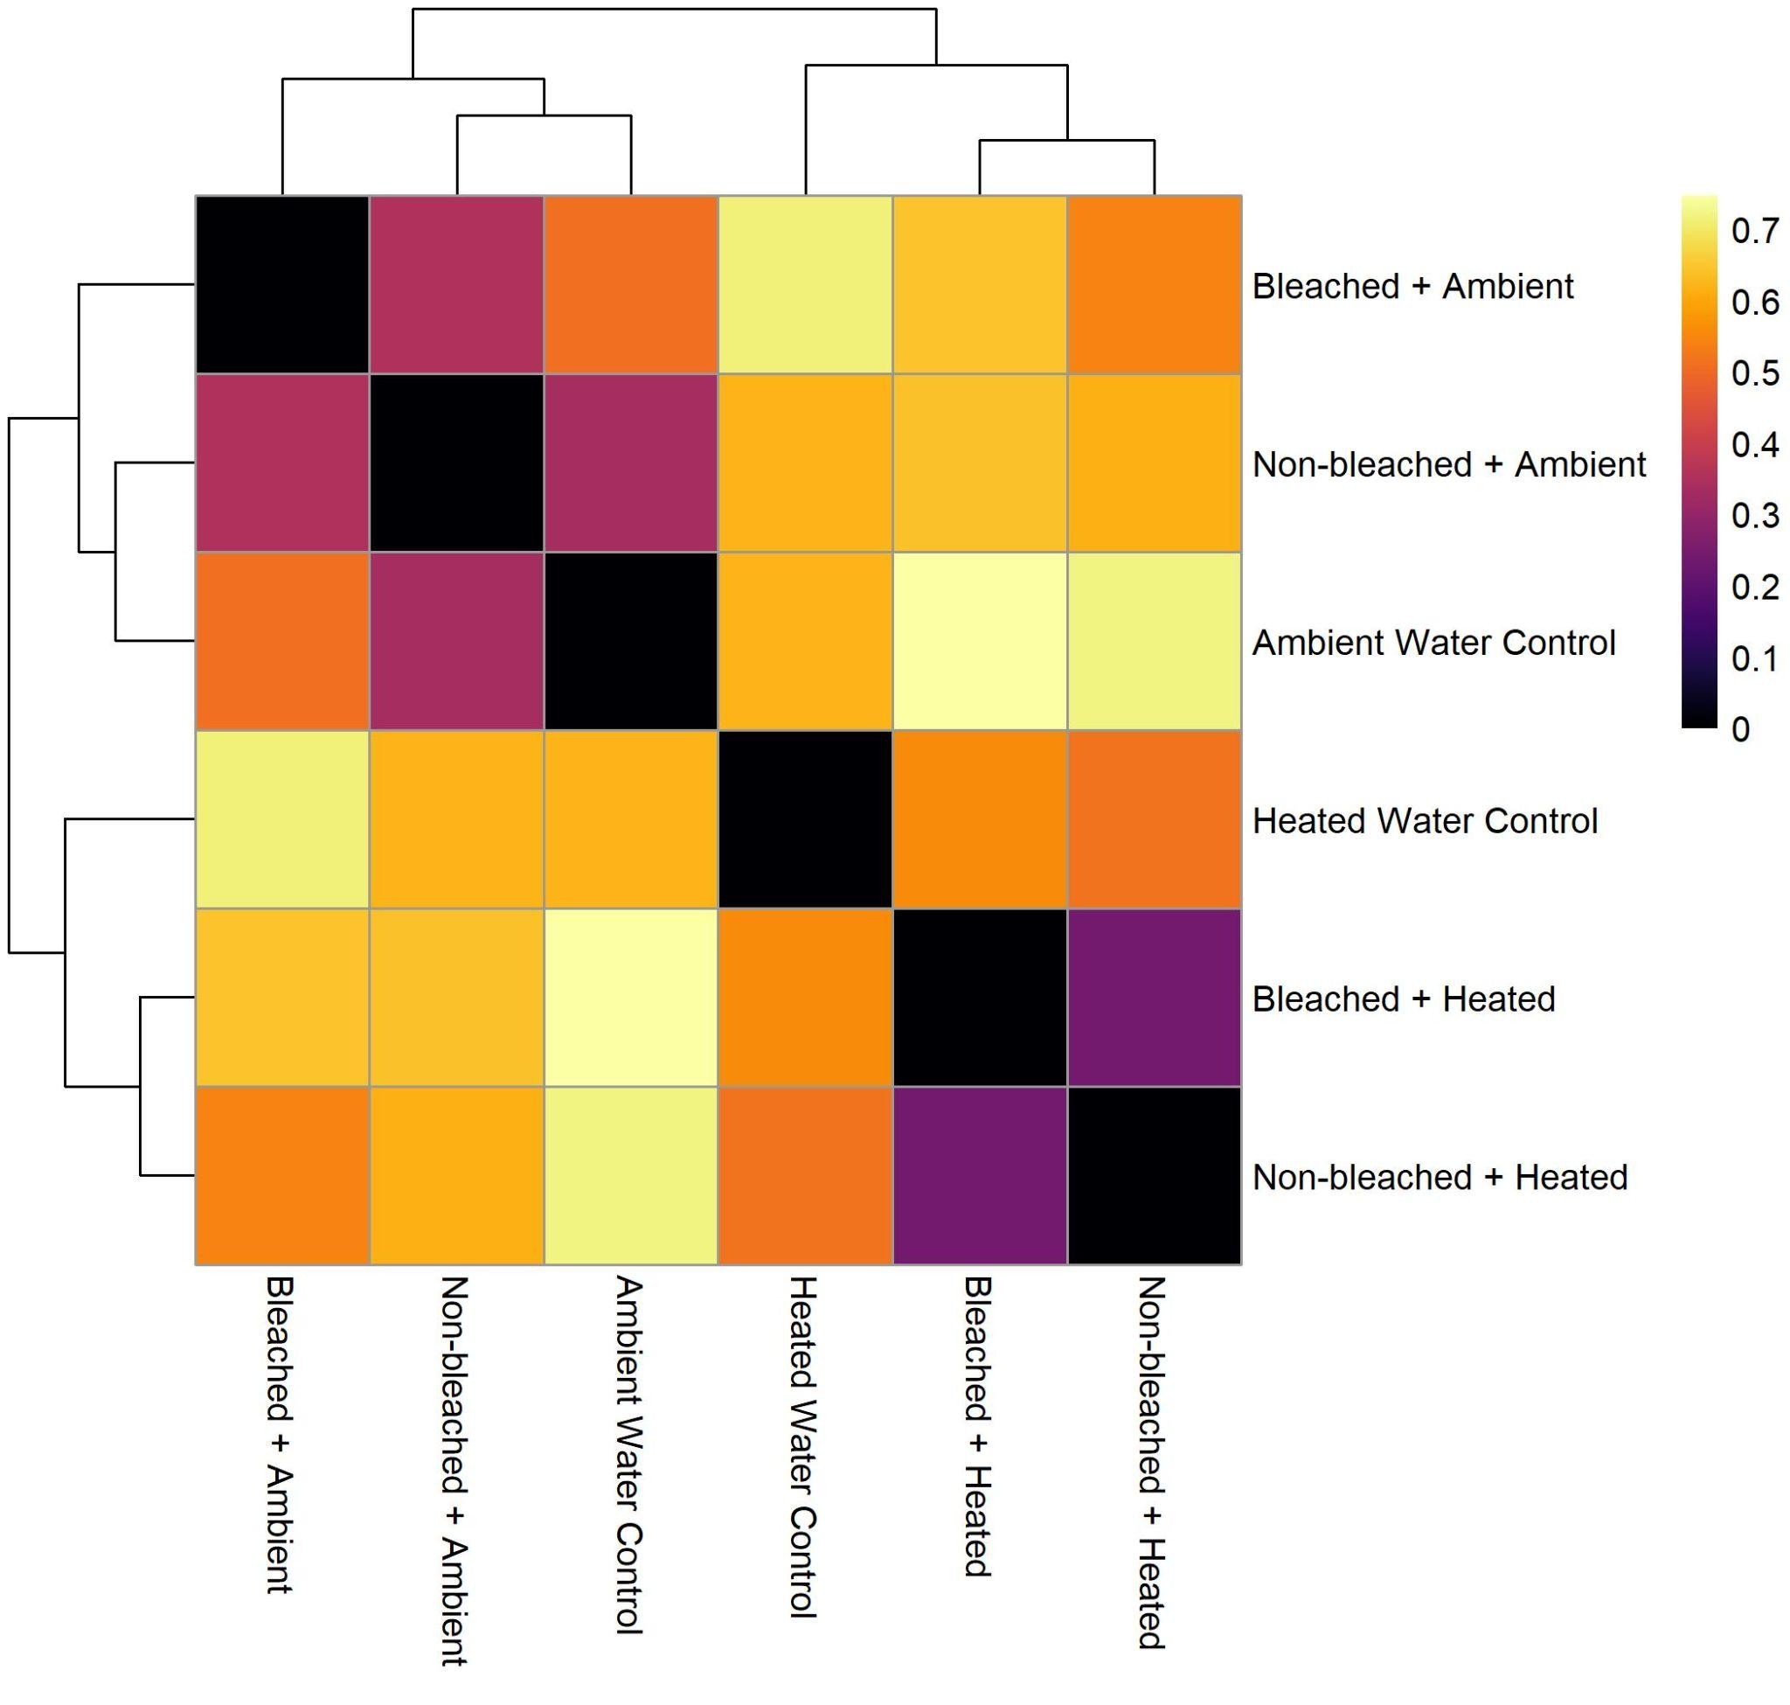
A
Figure 2: Box and whisker plots of surface area normalized DOC concentrations for the 4 coral treatments (A). Ward’s hierarchical clustering of multivariate metabolomic samples for T0 using the bray-curtis dissimilarity metric (B). Clustering heatmaps depict pairwise R² values between multivariate metabolomes from pairwise PERMANOVA (C).
B
C

Slide 4
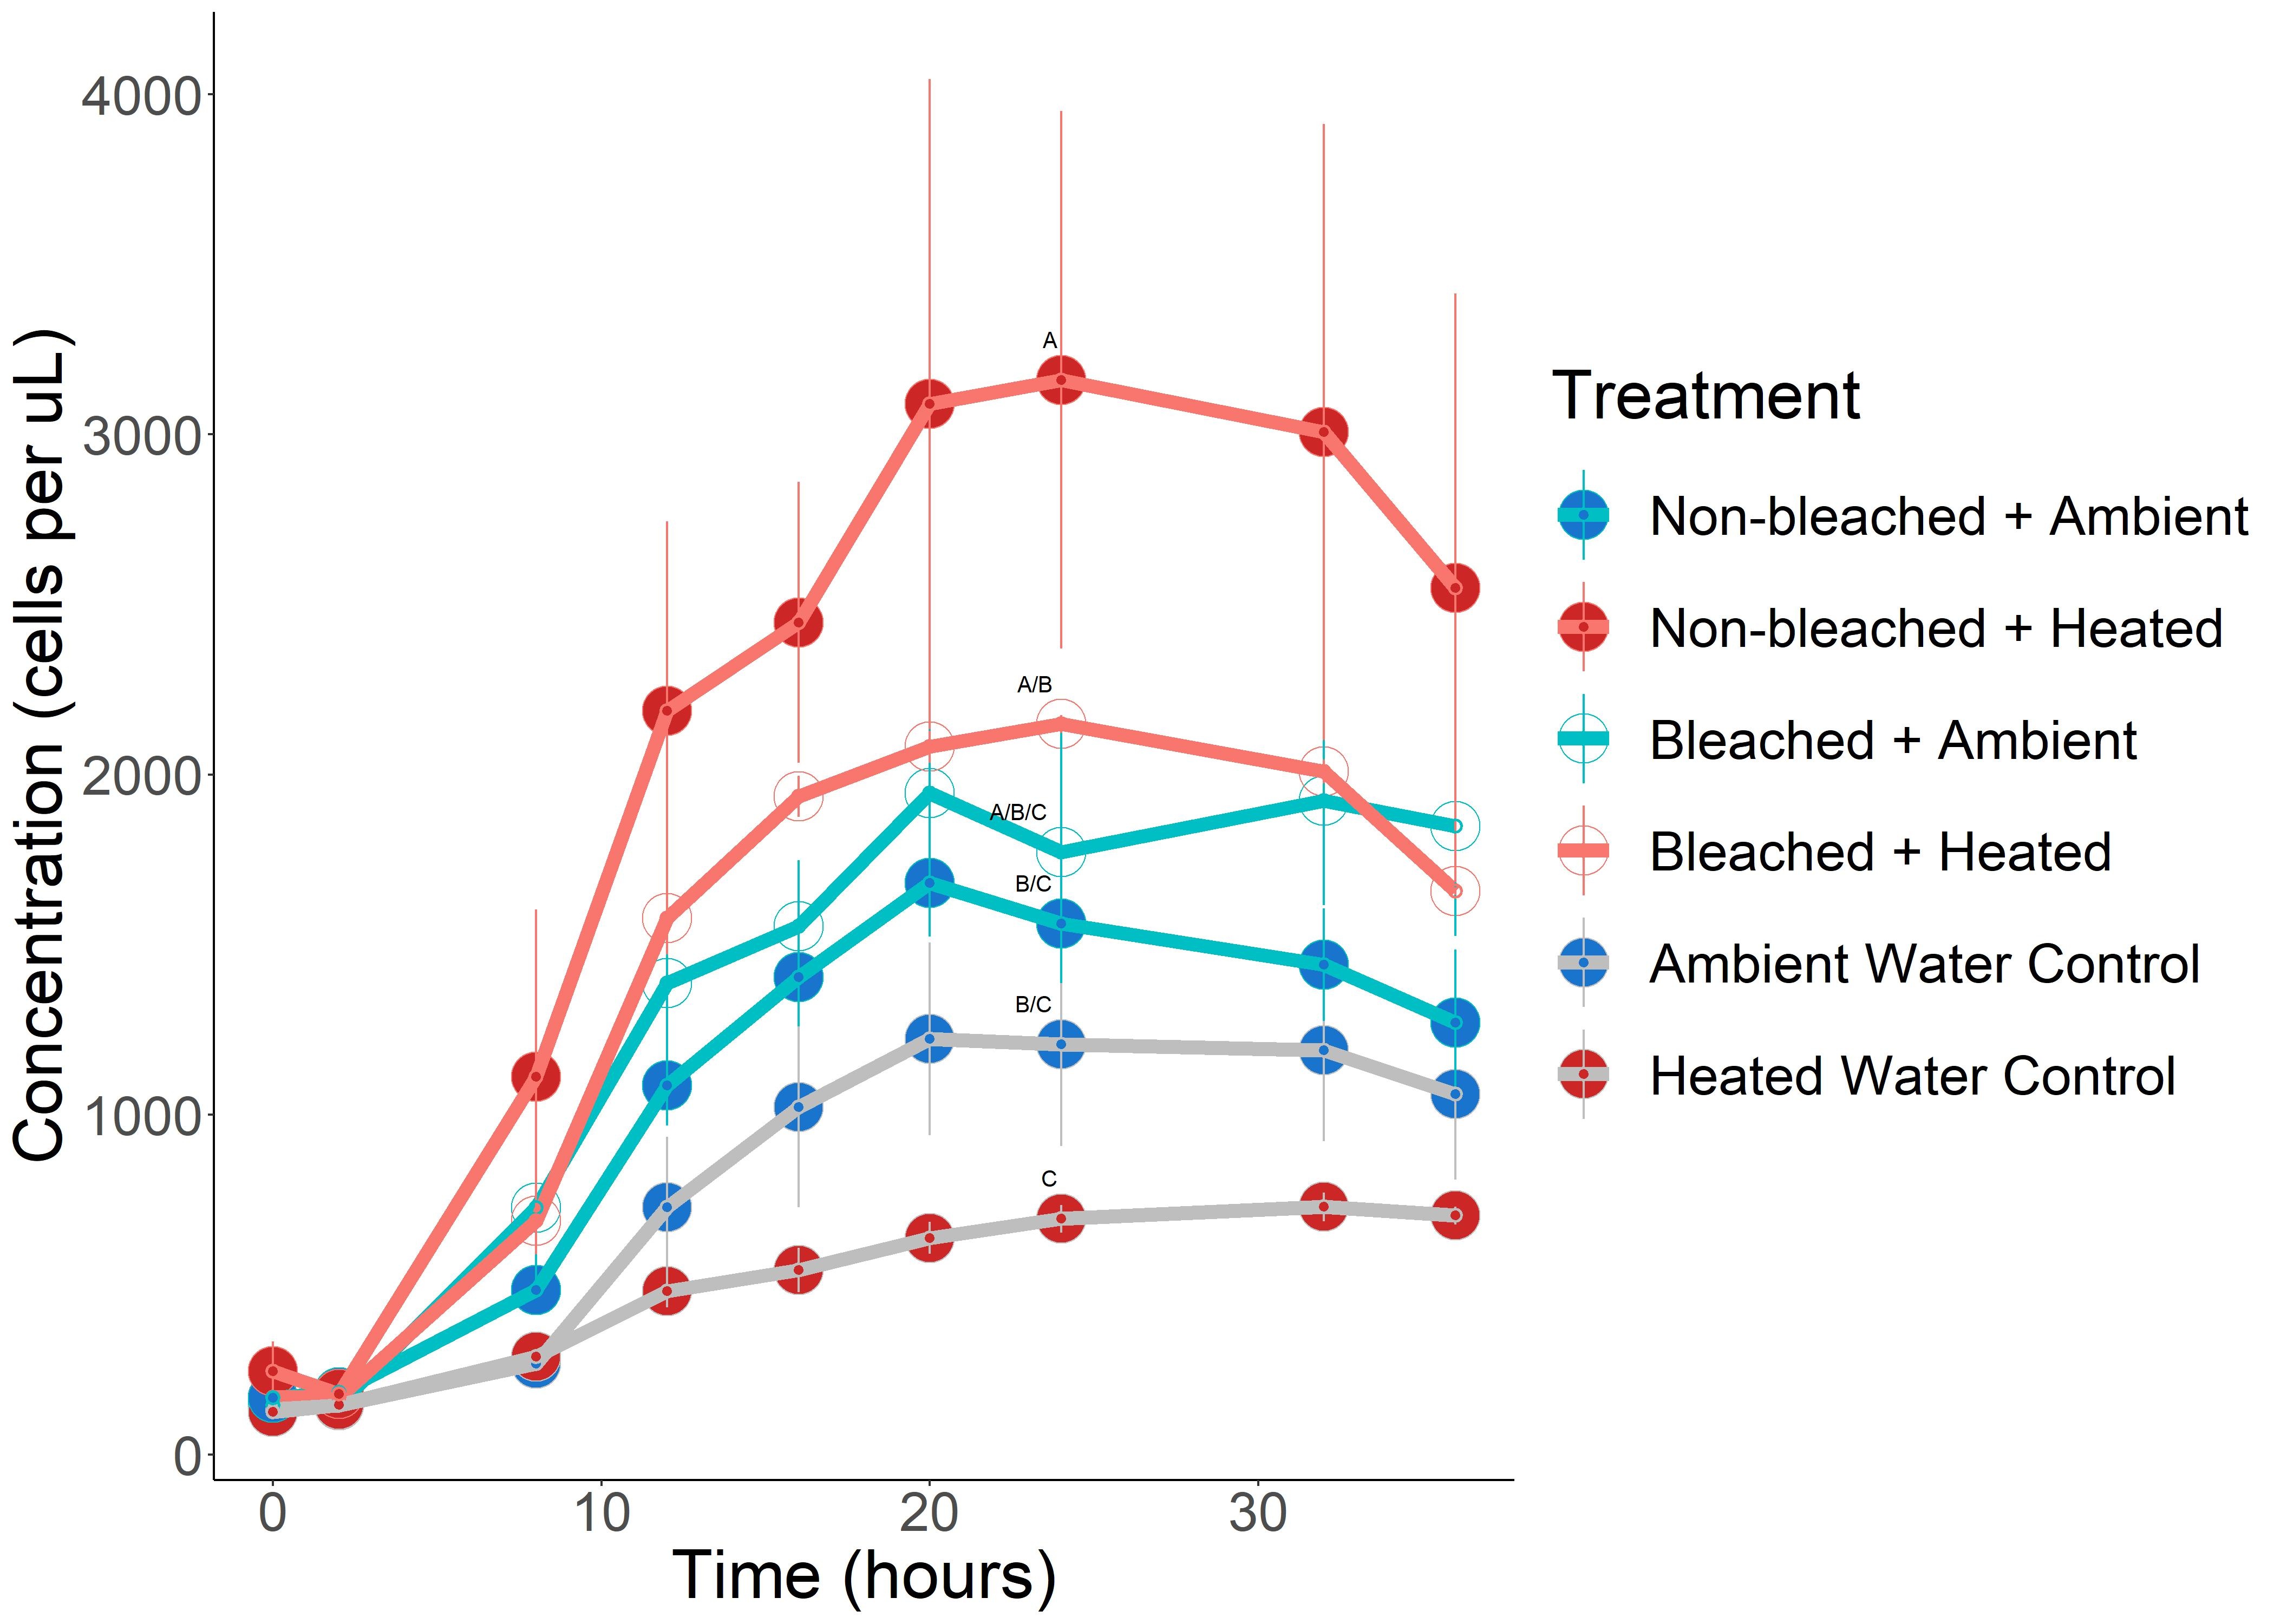
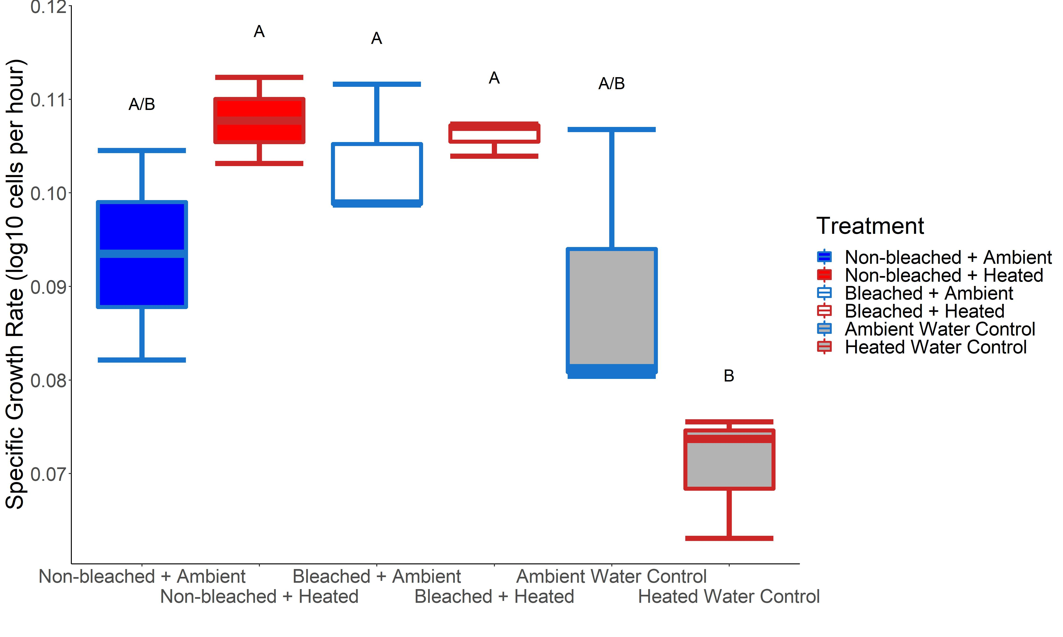
A
B
Figure 3: Bacterial growth curves for the 6 treatments in the 36 hour dark bottle incubation (A). Error bars indicate standard error of the mean. Box and whisker plots of bacterial specific growth rate, in log10 cells per hour, for the 6 treatments (B).

Slide 5
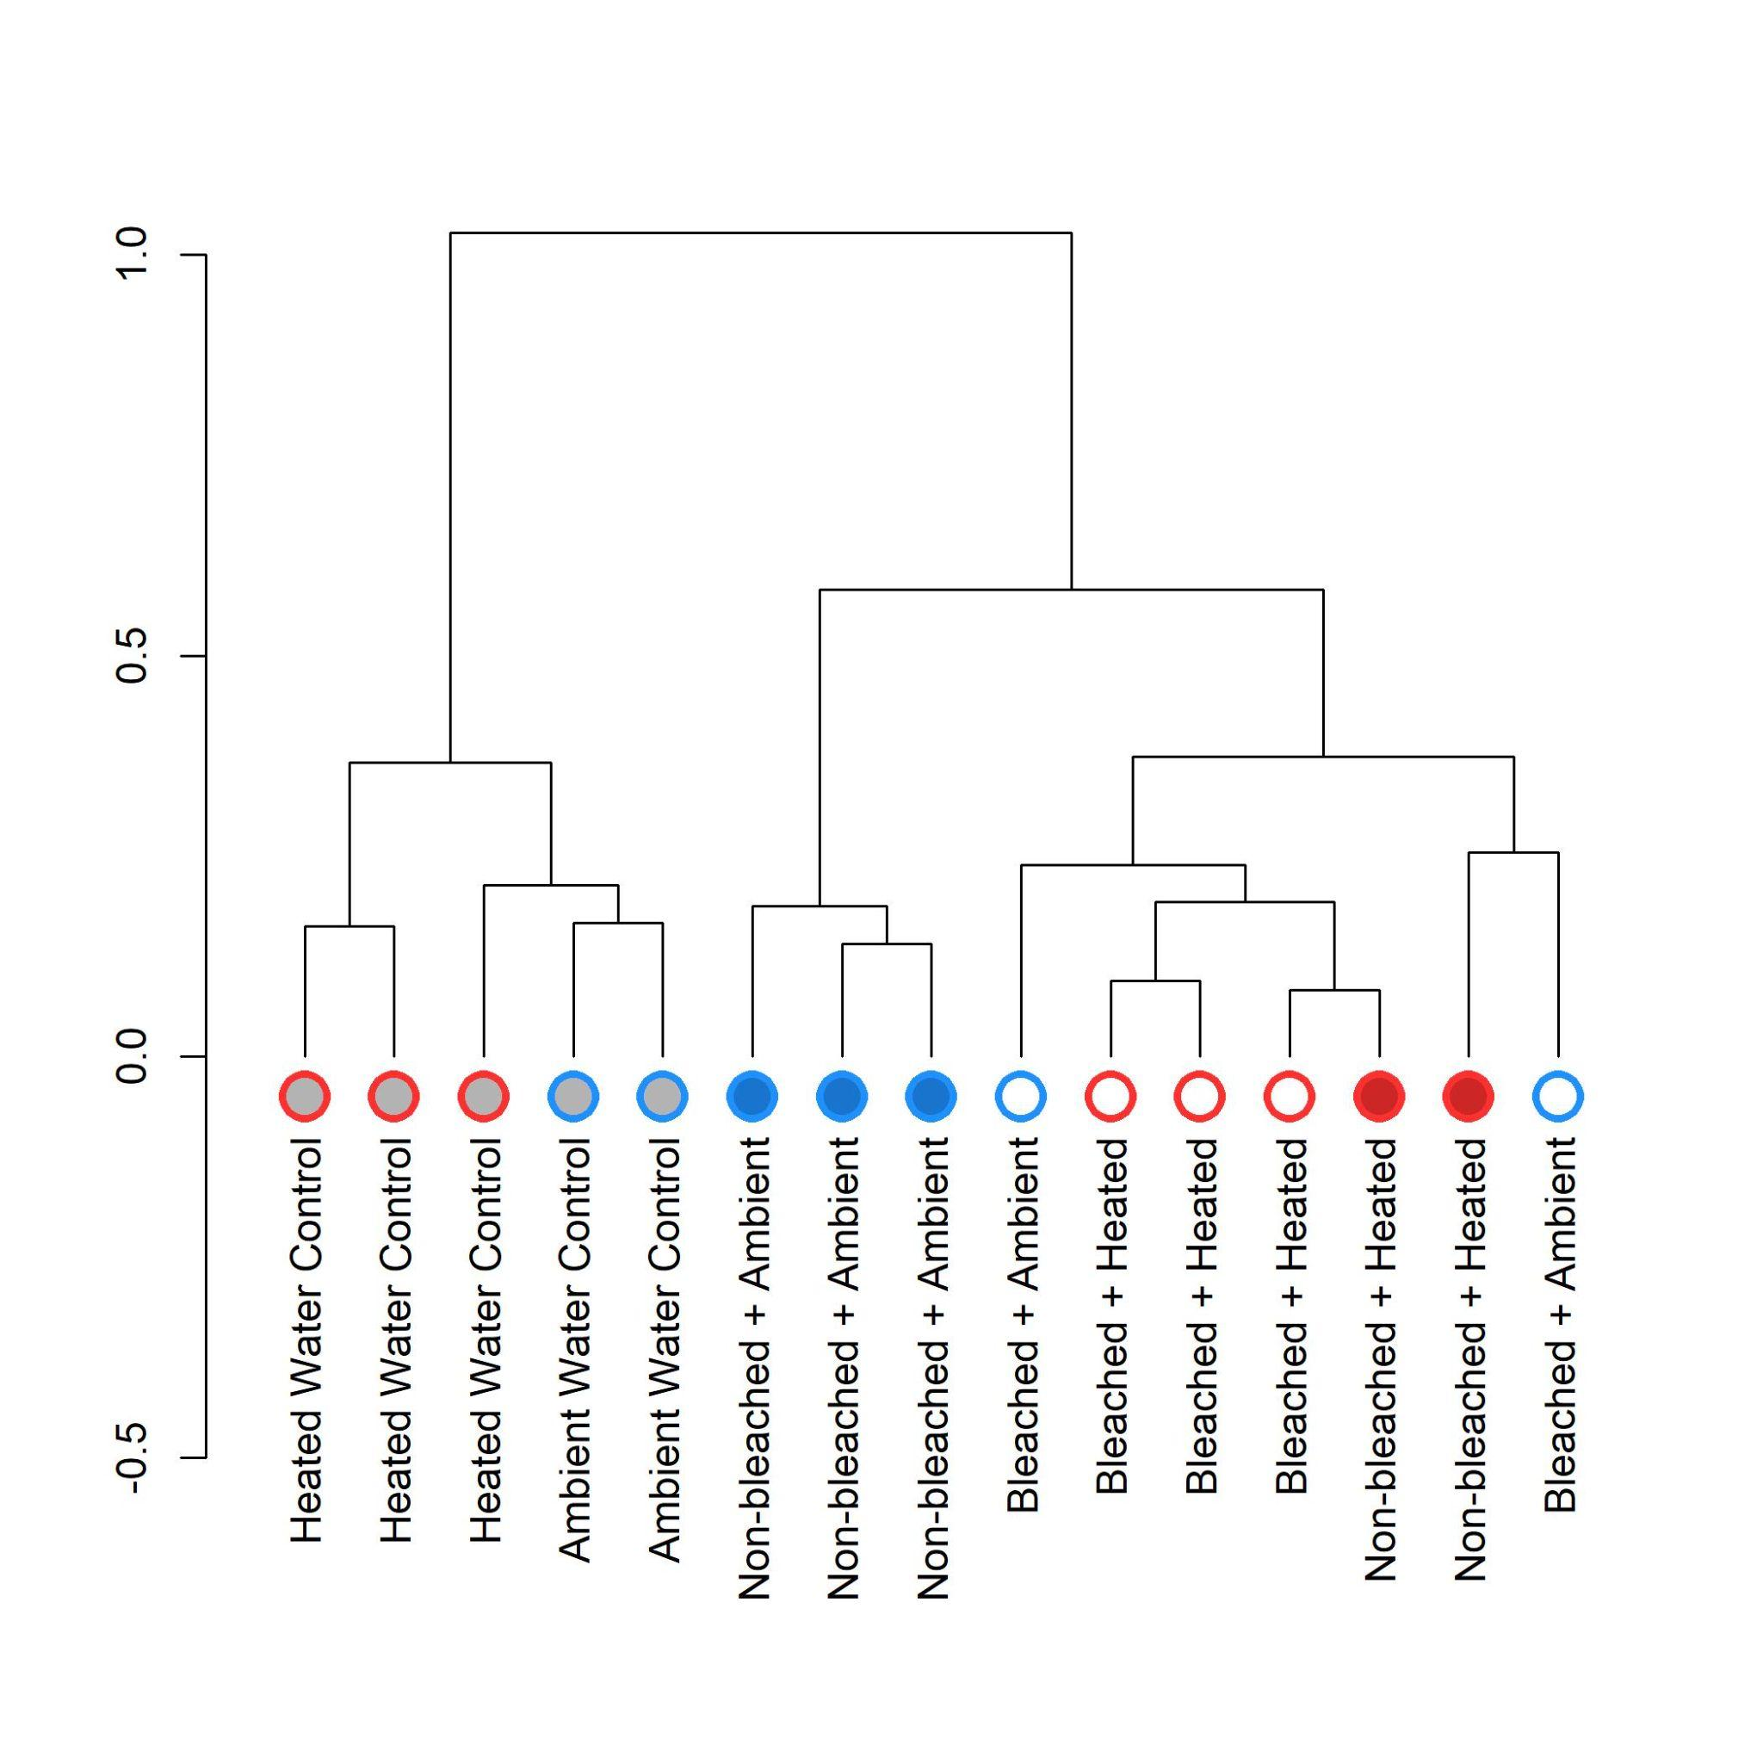
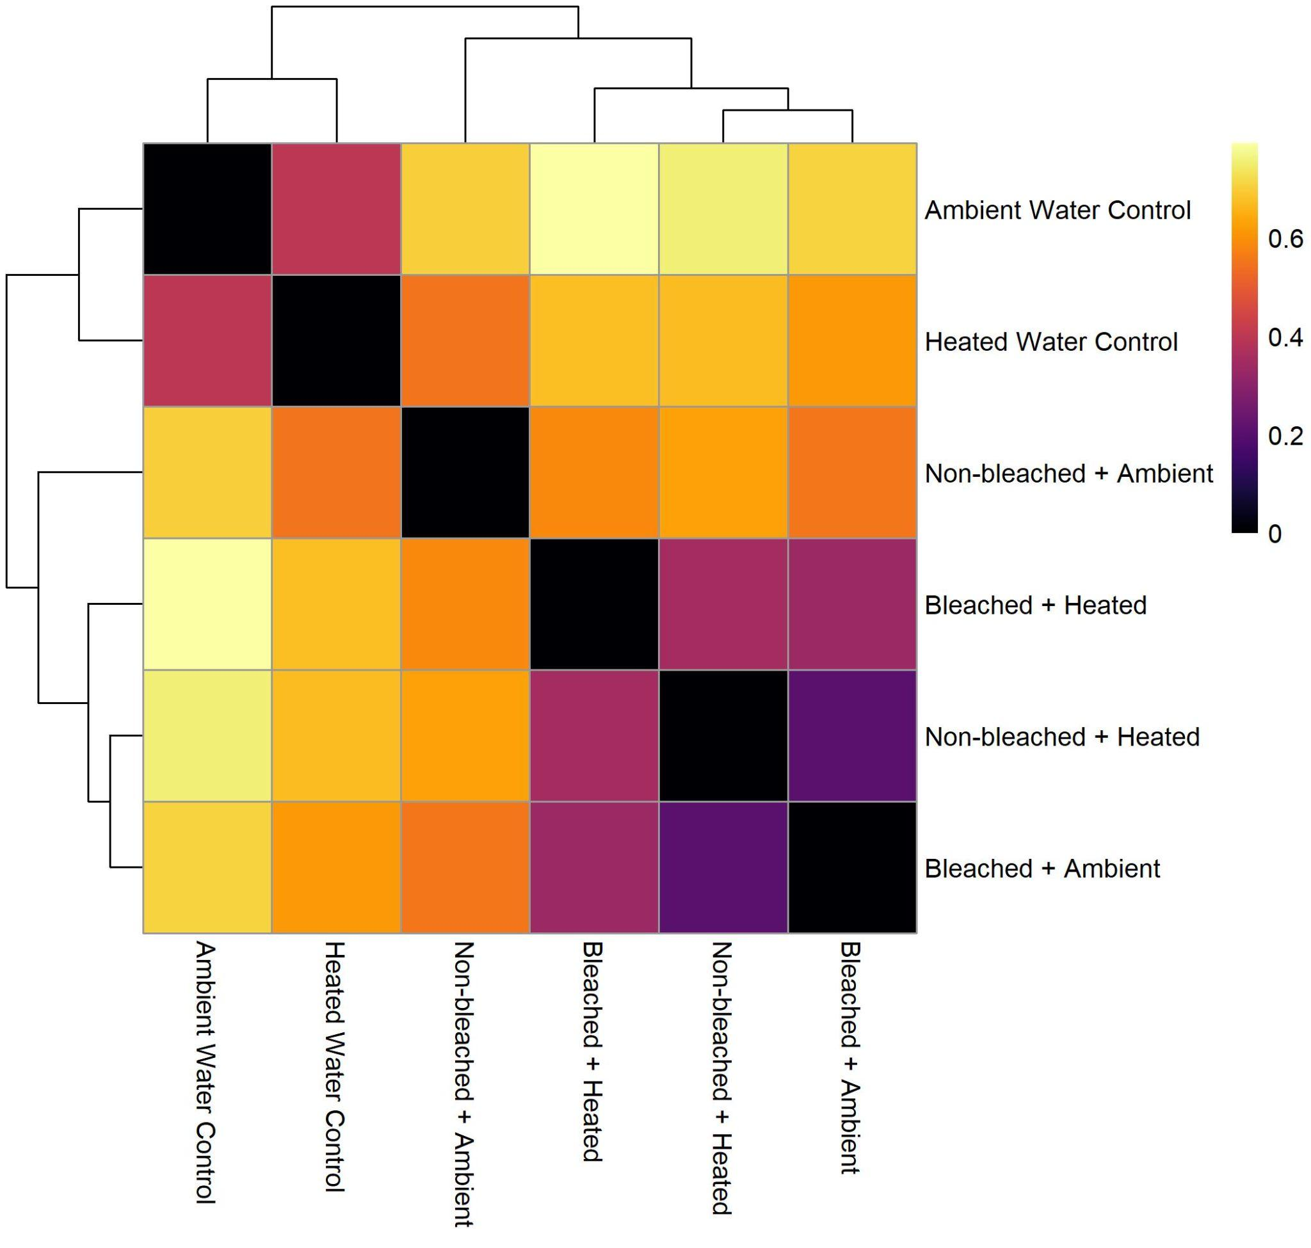
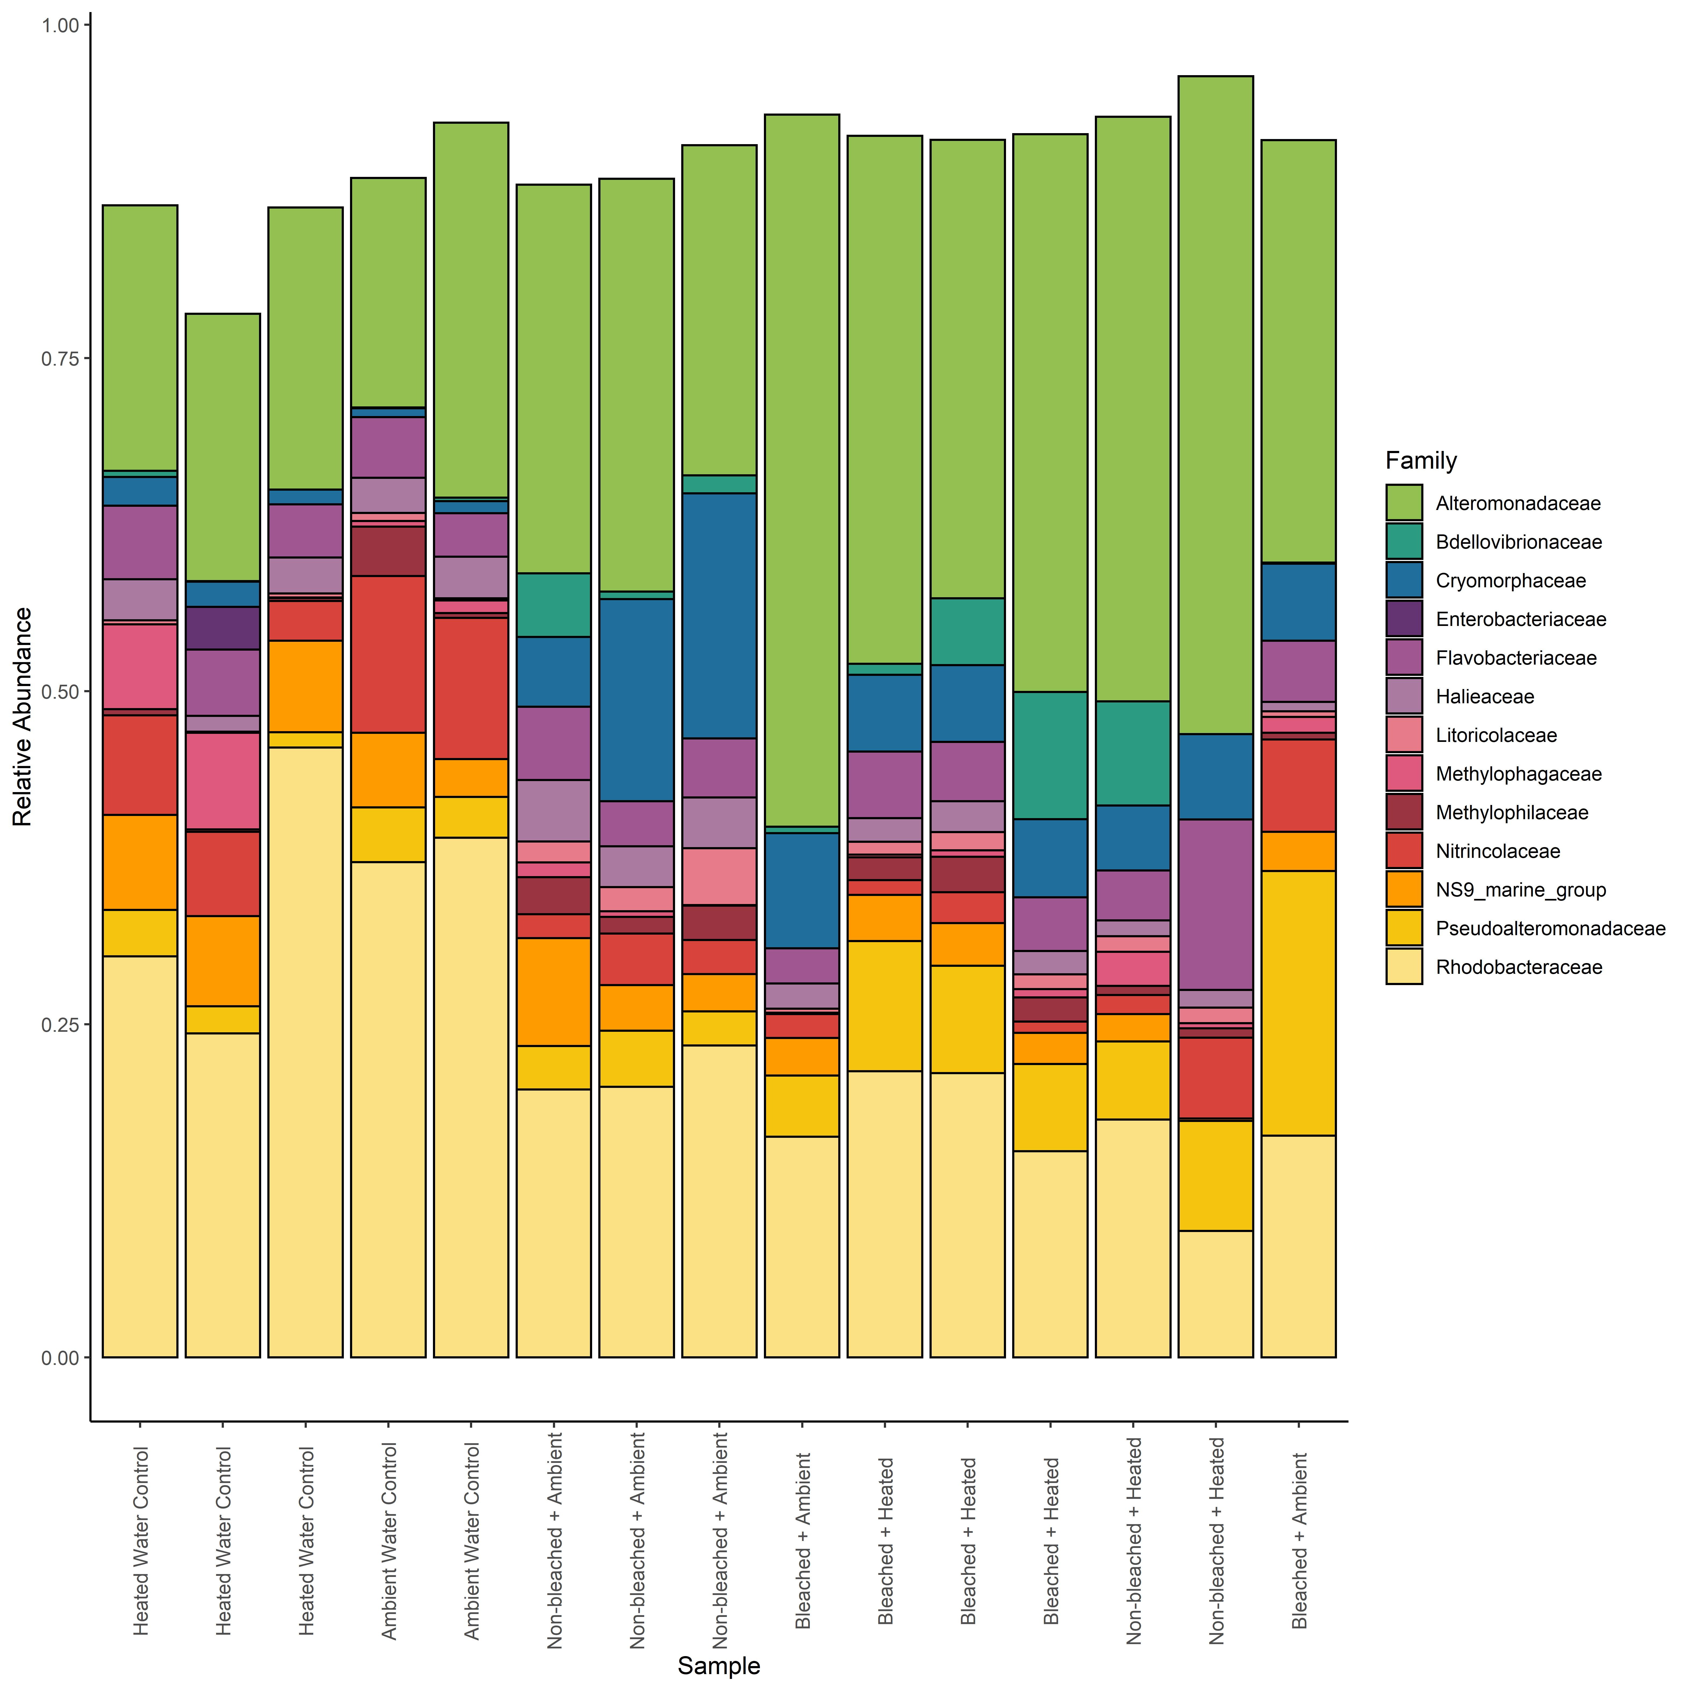
4B:
A
C
B
Figure 4: Ward’s hierarchical clustering of multivariate microbial community samples using Unifrac distances derived from 16S amplicon data (A). Stacked bar charts depicting relative abundances of the most abundant bacterial families in all samples (B). Bar charts are colored according to family. Abundant families were defined as families having a relative abundance ≥ .03 in at least one sample. Samples are ordered on the x axis according to the dendrogram. Clustering heatmaps depict pairwise R² values between multivariate metabolomes from pairwise PERMANOVA (C).

Slide 6
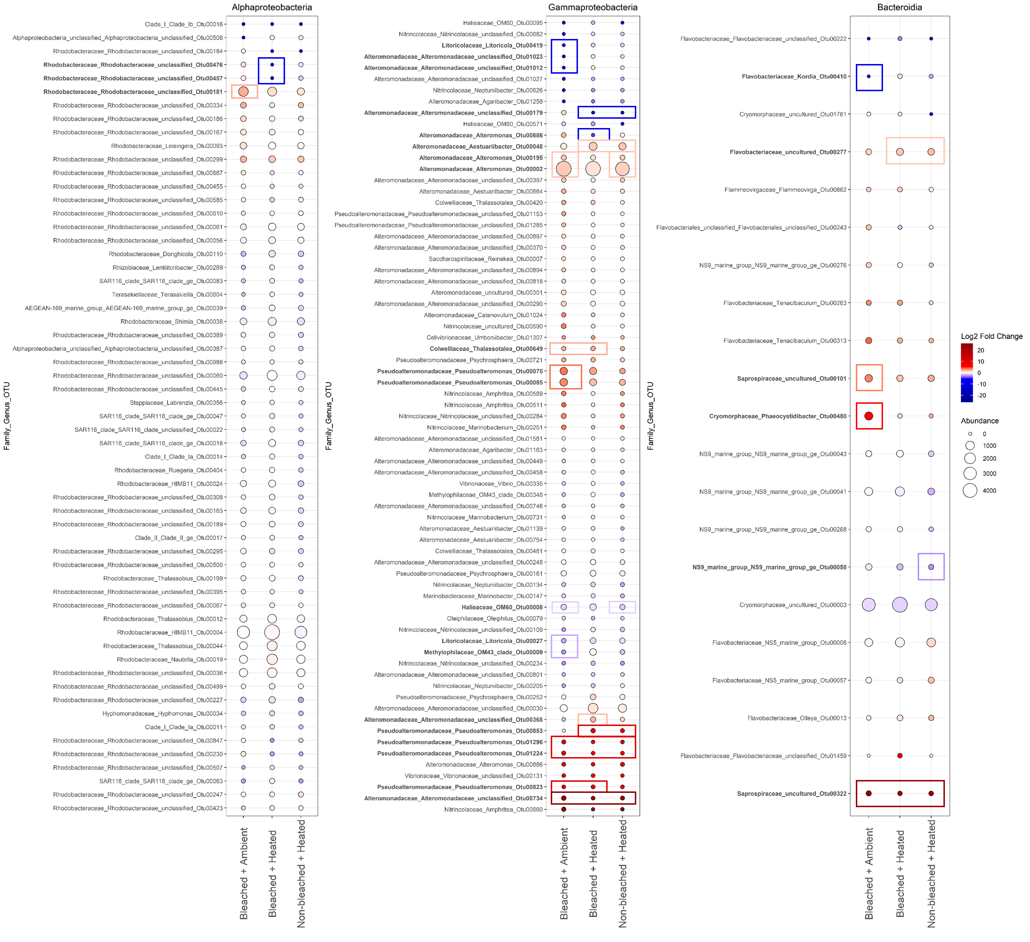
Figure 5: Direct comparison of bacterial ASVs enriched and/or depleted in the three stressed coral treatments relative to the “Non-bleached Ambient” controls. The log2 fold change of the 159 most abundant/prevalent ASVs in the three coral stress treatments compared to the “Non-bleached Ambient” treatment (A). Points are colored by log2 fold change, with warmer colors indicating more enrichment and cooler colors indicating more depletion relative to the “Non-bleached Ambient” treatment. Point size indicates the mean abundance of a given ASV in a given treatment. ASVs are labeled according to their family, genus, and OTU Number on the y axis. ASVs labeled in bold were determined by DESEq2 to be significantly differentially abundant in at least one of the three treatments compared to “Non-bleached Ambient” controls (p≤.05 after FDR). Boxes denote in which treatment there is a significant change and the color of the box indicates whether this was a significant enrichment (red) or depletion (blue).

Slide 7
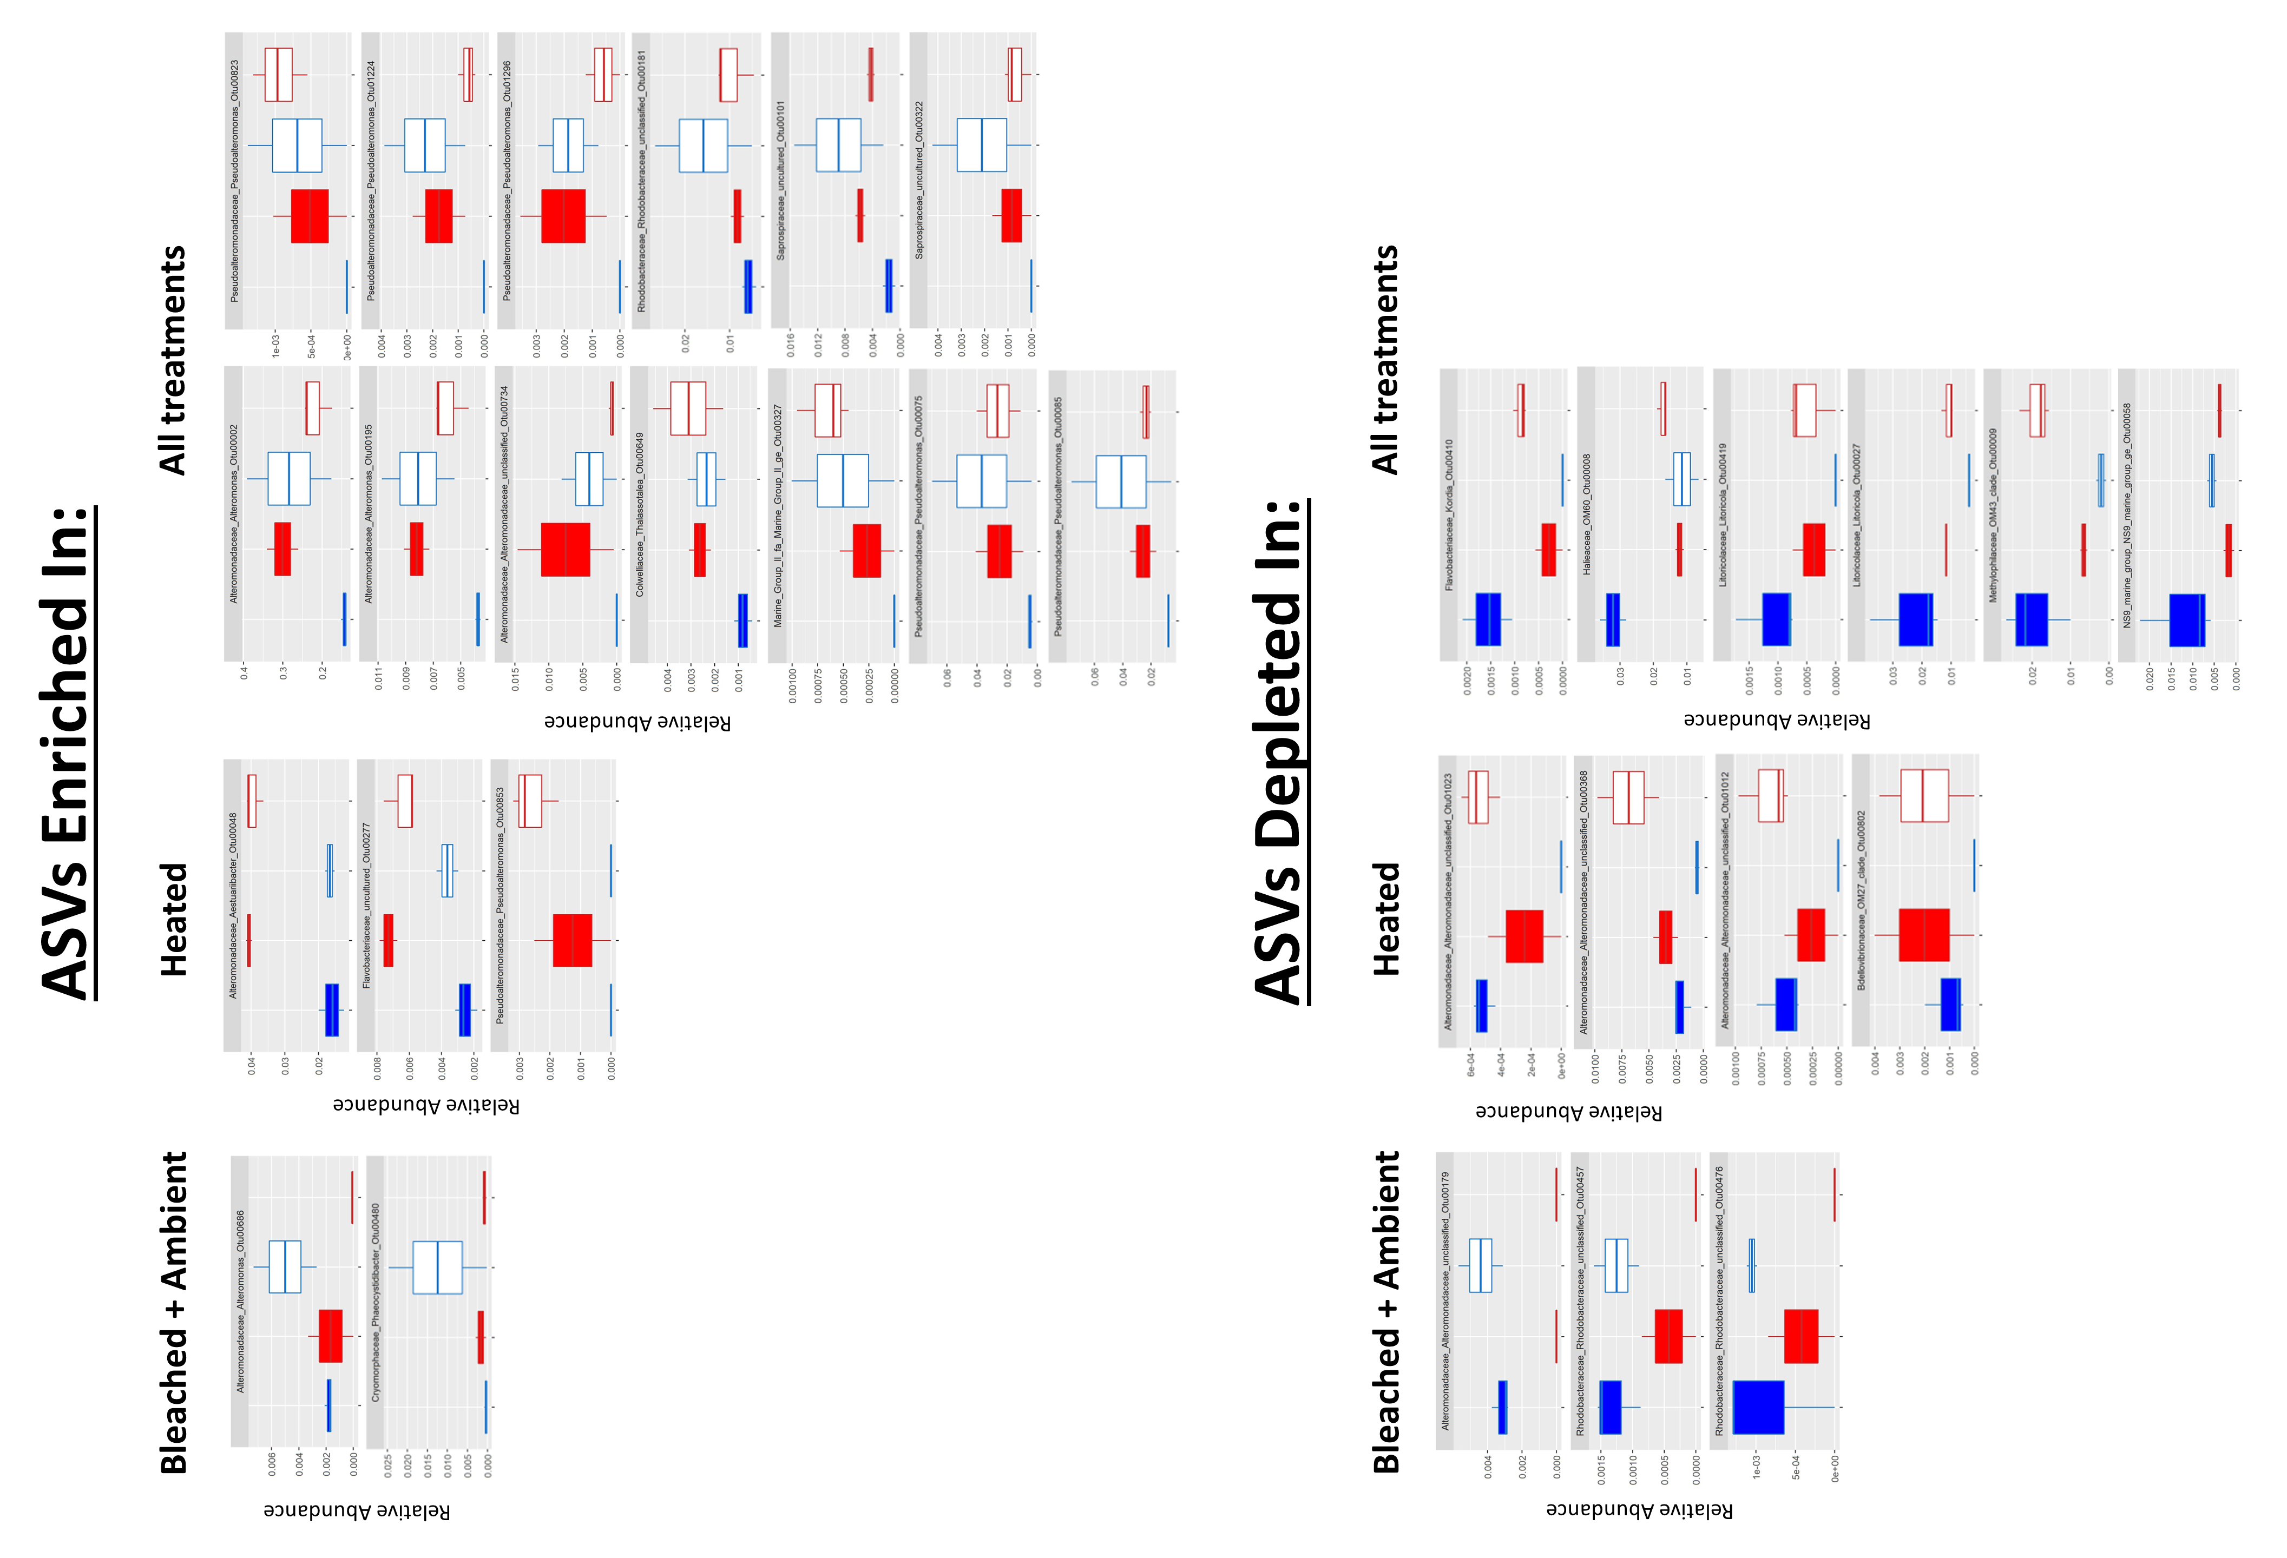
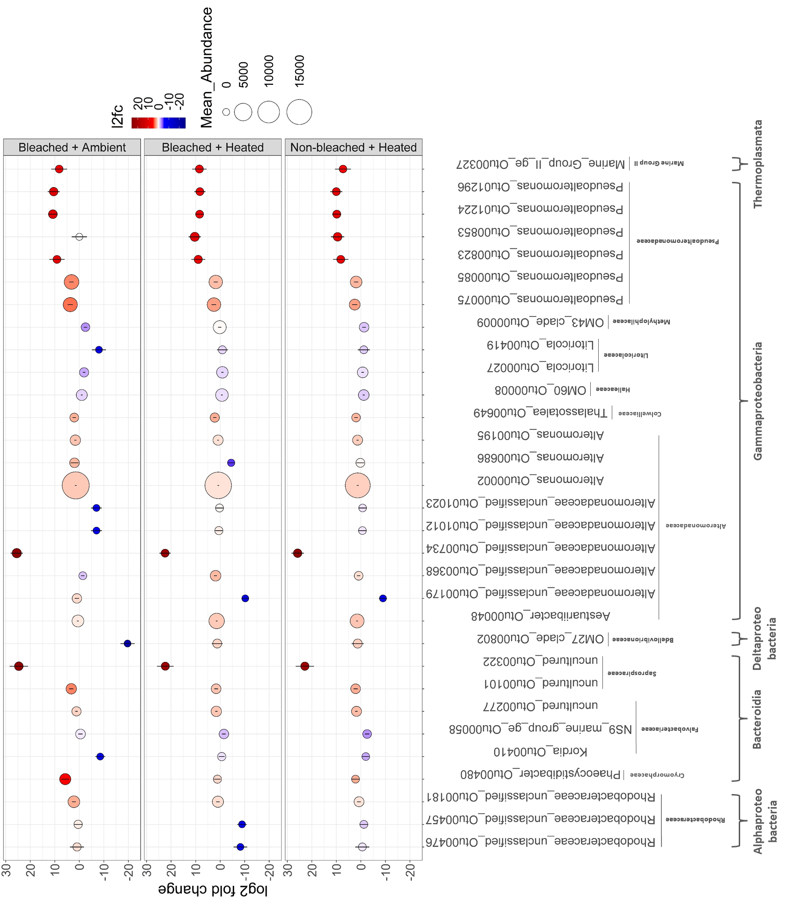
B
C
Figure 6: Visualization of the 31 ASVs determined to be significantly differentialy abudant compared to “Non-bleached + Ambient” samples by DESEq2. (A) Dotplot of the log2 fold-change values for the 31 ASVs for the 3 coral stress treatments. Each dot represents a given ASV in a given treatment. Dot height on the y-axis and color correspond to l2fc values. Error bars depict the standard error of each l2fc value calculated by DESEq2. Dot size corresponds to mean raw abundance. Each ASV is labeled according to it’s Class, Family, and Genus_OTUNumber on the x axis. (B) and (C) Boxplots of the relative abundance of significant ASVs enriched (B) or depleted (C) in any of the 3 coral stress treatments. Each plot is labeled accordig to the ASV family, genus, and number. Relative abundance was derived from the non-subsampled, raw abundance data used in DESEq2. Plots are seperated into labled columns indicating ehich treatment(s) ASVs are enriched in.
A

Slide 8
Supplemental figures

Slide 9
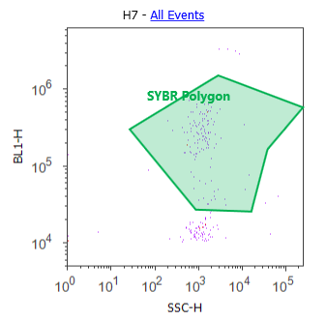
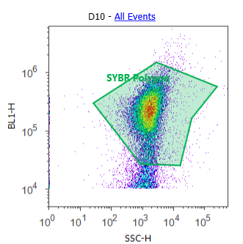
Control
Sample
Figure S1: Representative density plots of gated SYBR polygon derived bacterial counts for a SYBR stained .2µm filtered milliq control and a SYBR stained sample.

Slide 10
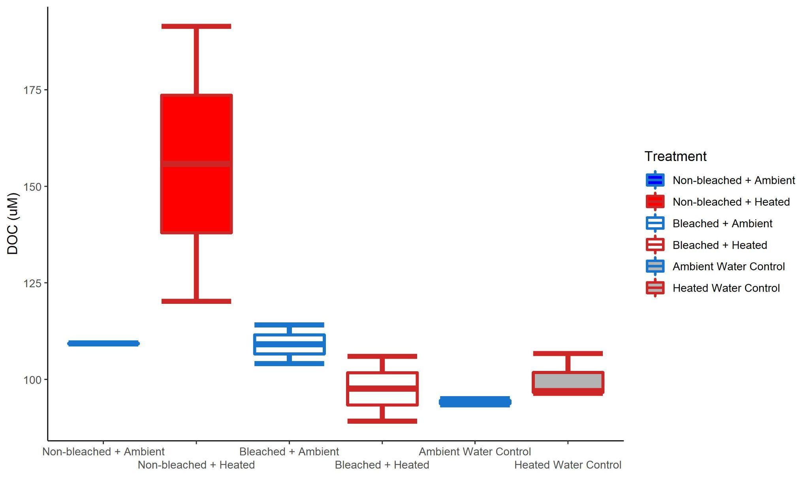
S1
Figure S2: Box and whisker plots of raw DOC exudate concentrations (µM) for the 6 treatments.

Slide 11
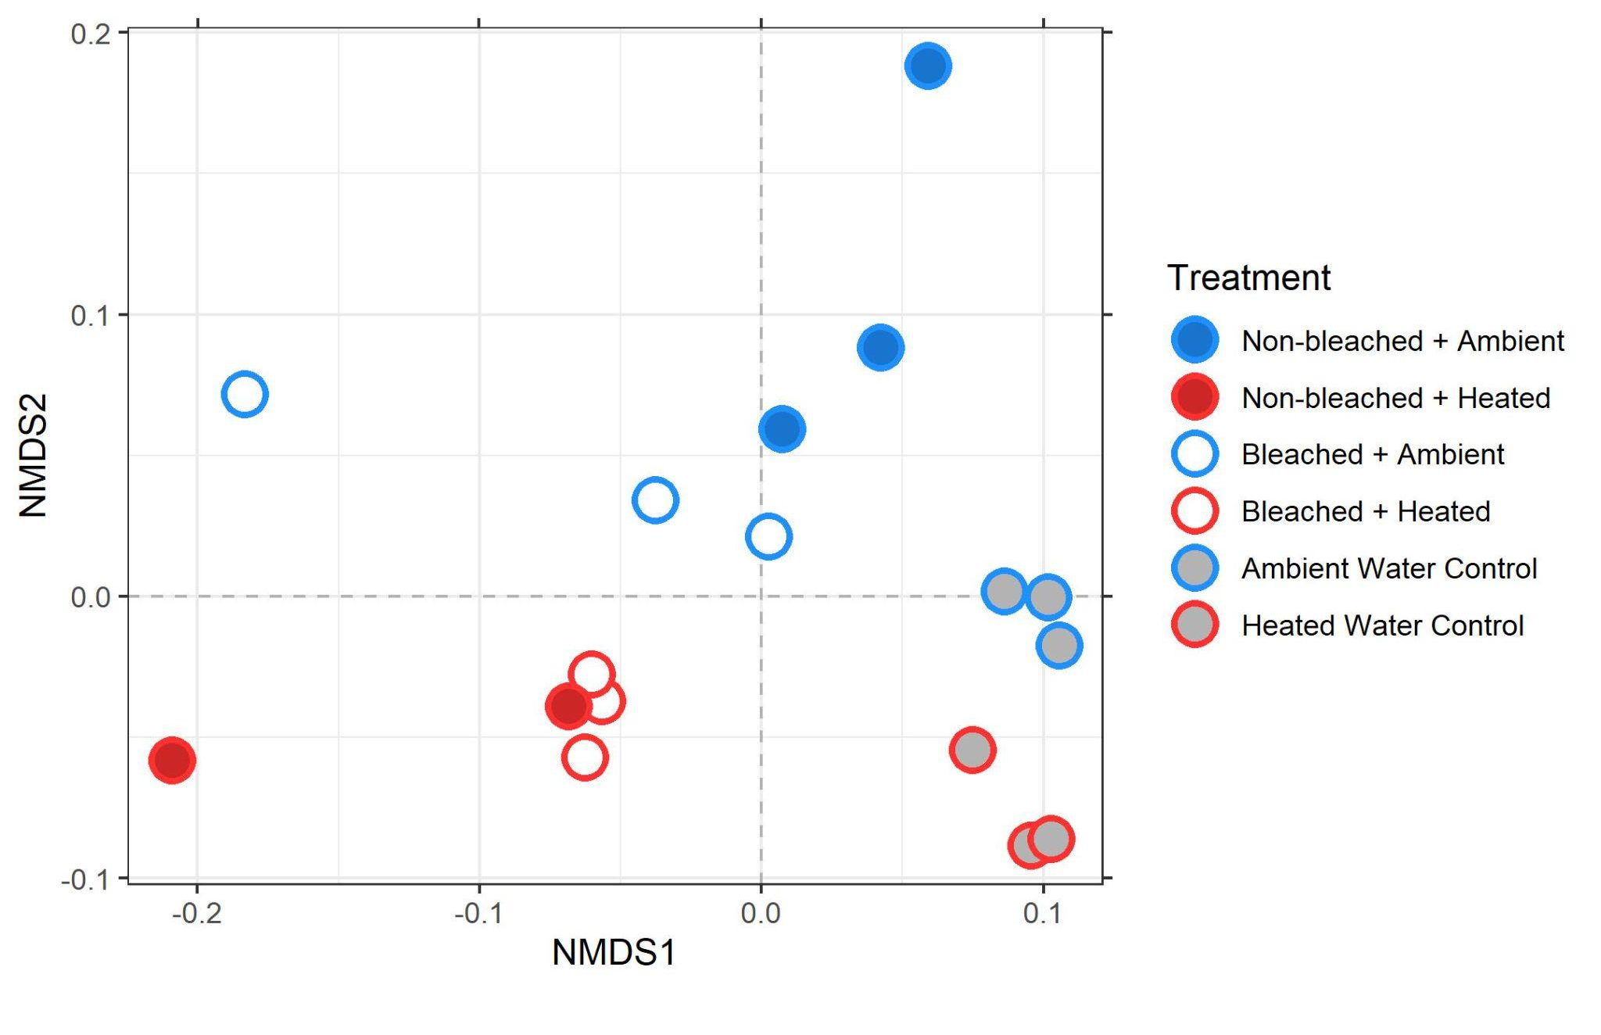
stress = 0.0836
Figure S3: Non-metric multidimensional scaling plot of t0 metabolomic samples using bray curtis dissimilarity.

Slide 12
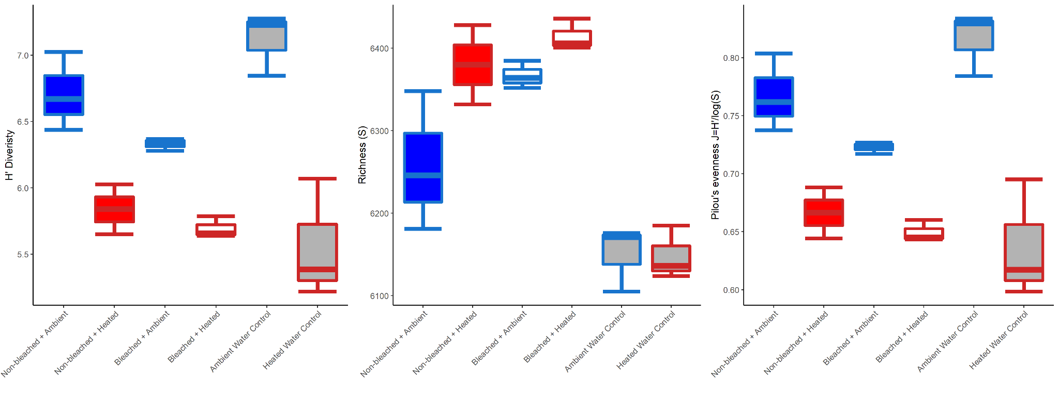
Figure S4: Box and whisker plots of t0 exudate metabolomic alpha diversity (Shannon’s H, Richness, and Pilou’s evenness).

Slide 13
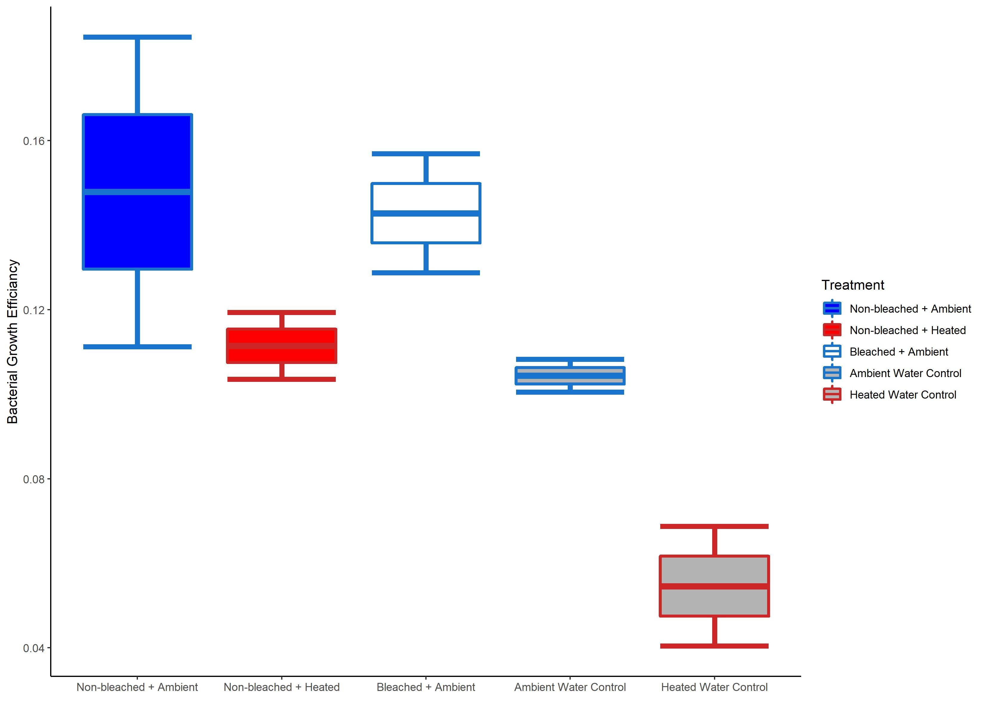
Figure S5: Box and whisker plots of bacterial growth efficieny (BGE) of microbial communities in the 36 hour dark incubation. BGE for the “Bleaced + Heated” treatment was unable to be calculated due to DOC contamination.

Slide 14
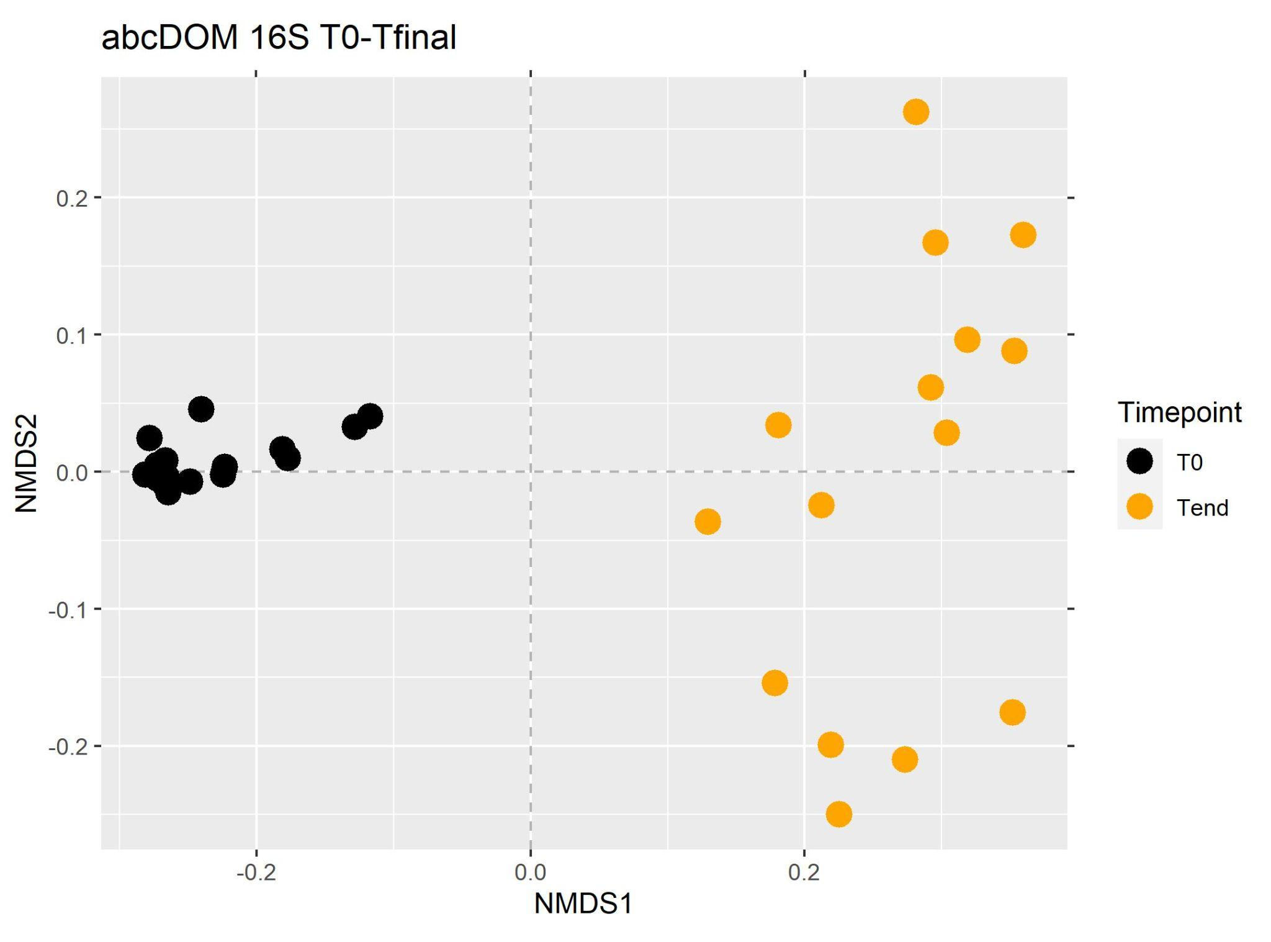
Figure S6: Non-metric multidimensional scaling plot of bacterial communities from start and end of bottle incubation using unifrac dissimilarity.

Slide 15
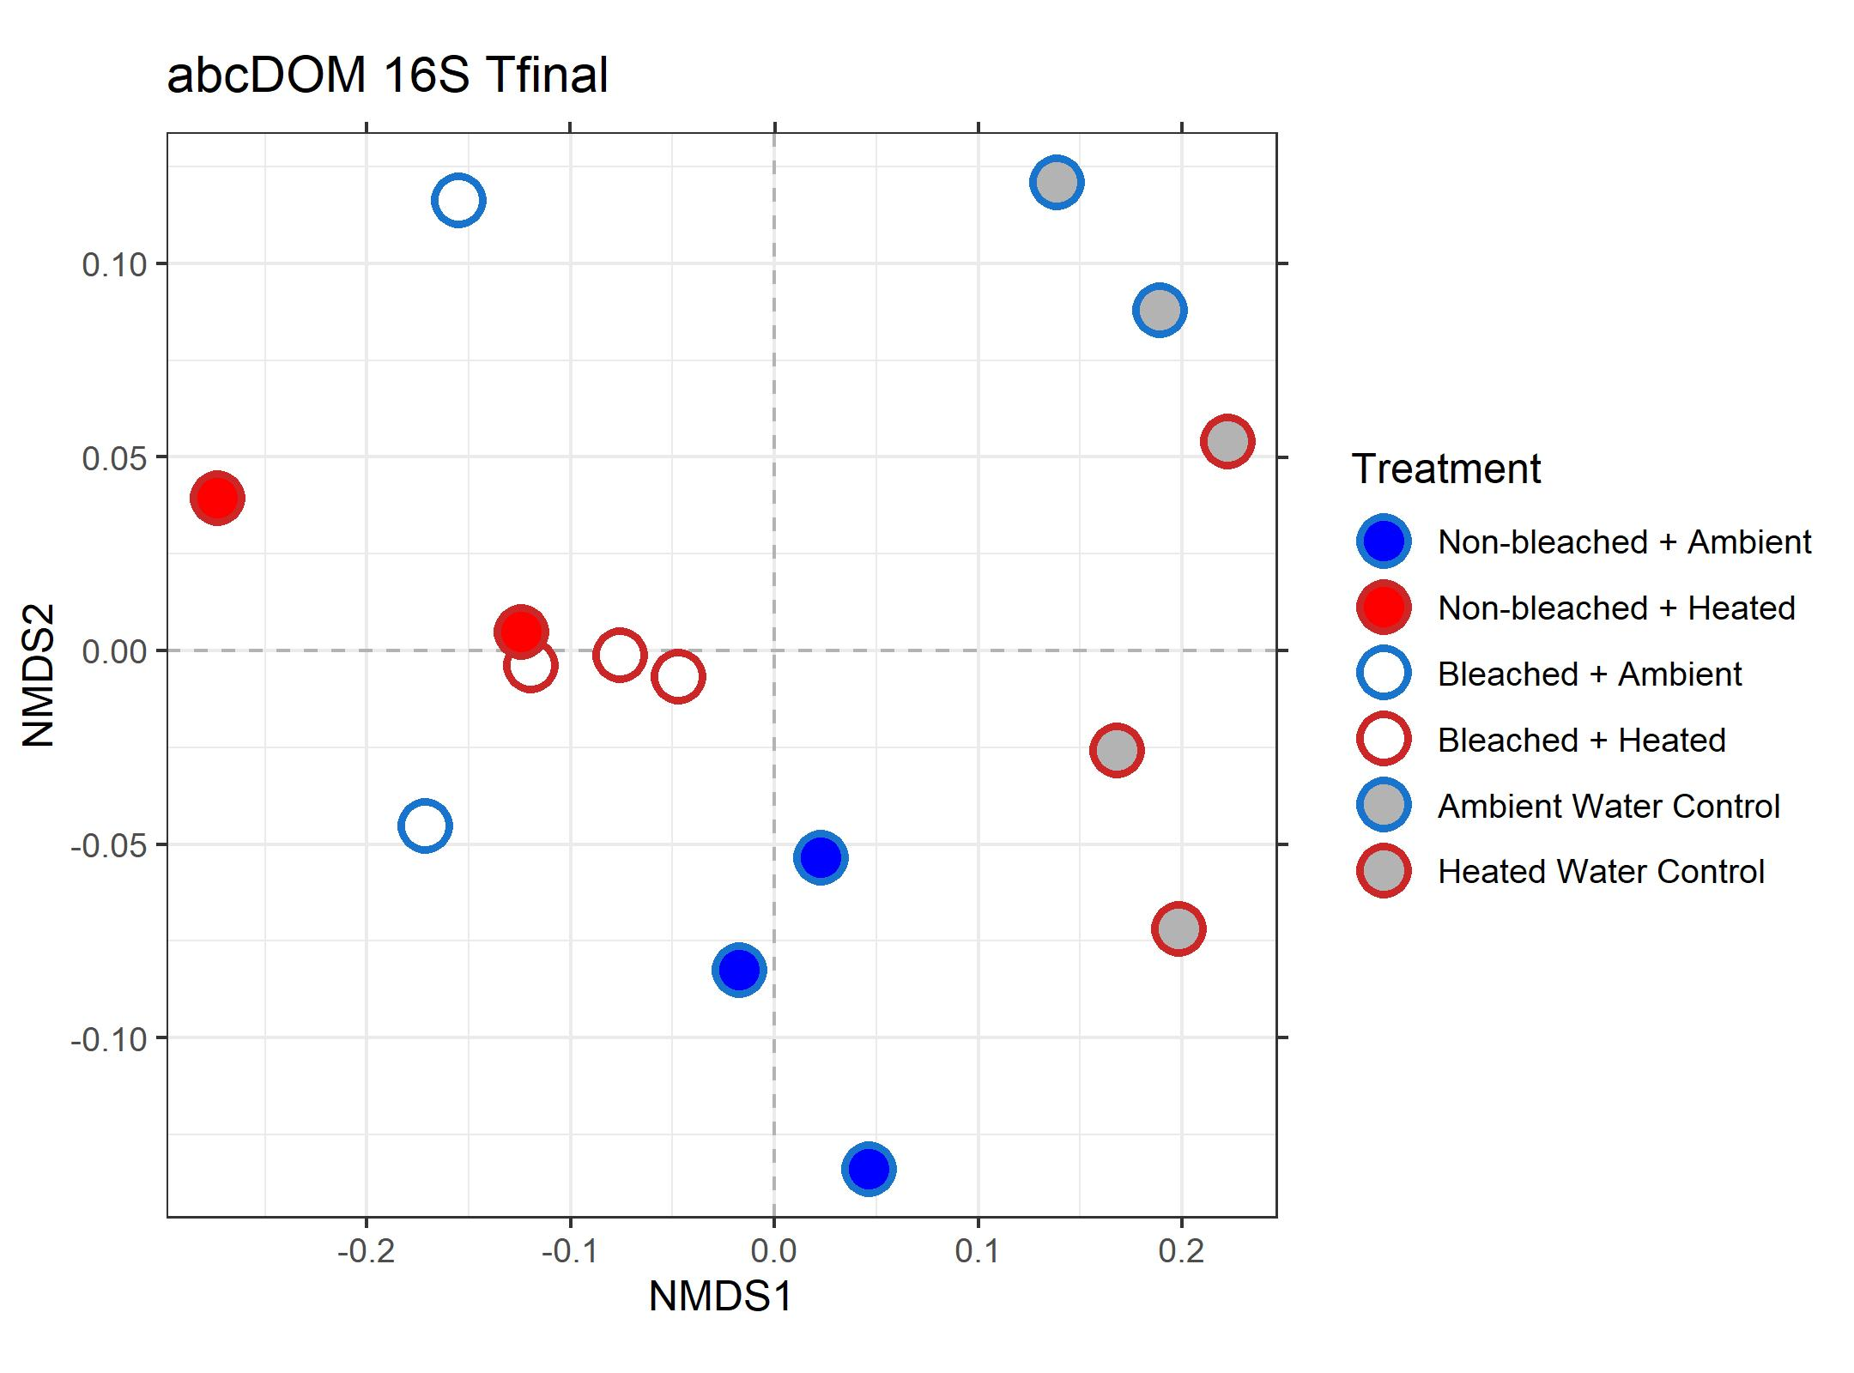
stress = 0.0816
Figure S7: Non-metric multidimensional scaling plot of bacterial communities the end of the bottle incubation using unifrac dissimilarity.

Slide 16
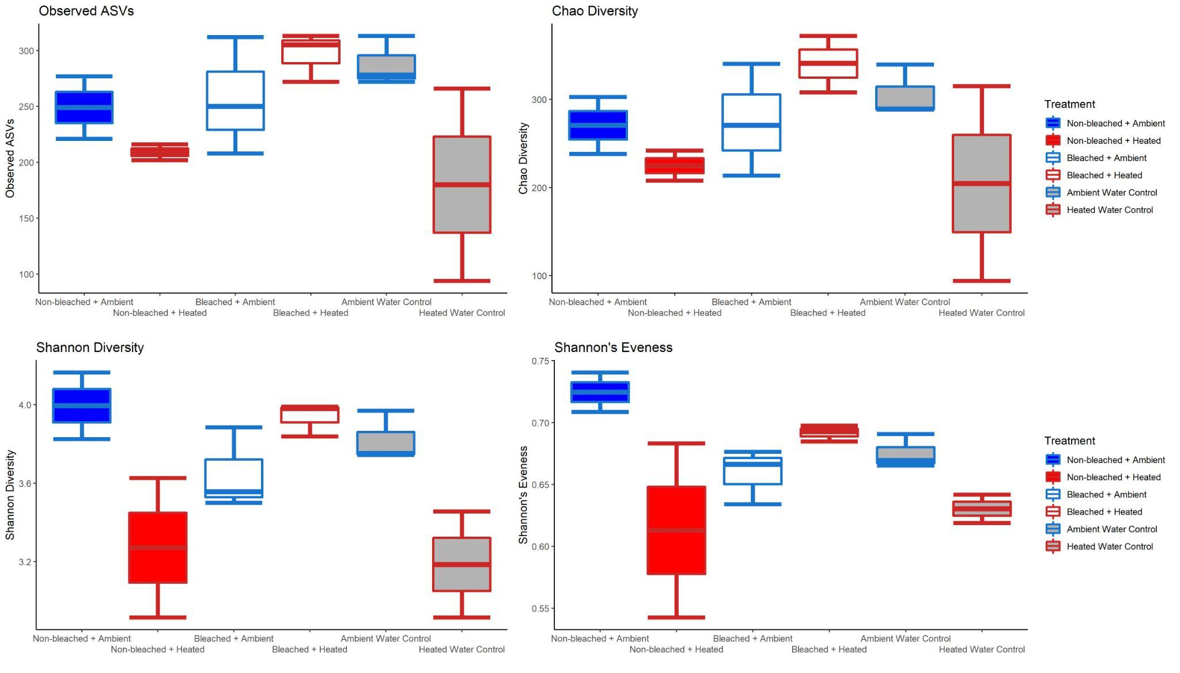
Figure S8: Box and whisker plots of the alpha diversity of the bacterial communities at the end of the incubation

Slide 17
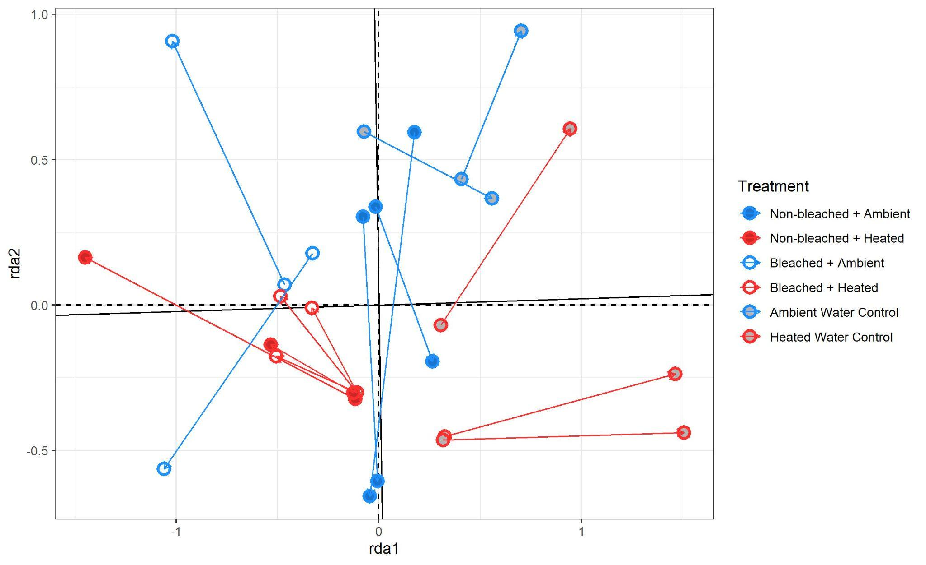
S10
Figure S9: Procrustes visualization of multivariate metabolomic and microbial samples. Arrows point from microbial samples to corresponding metabolomic samples.

Slide 18
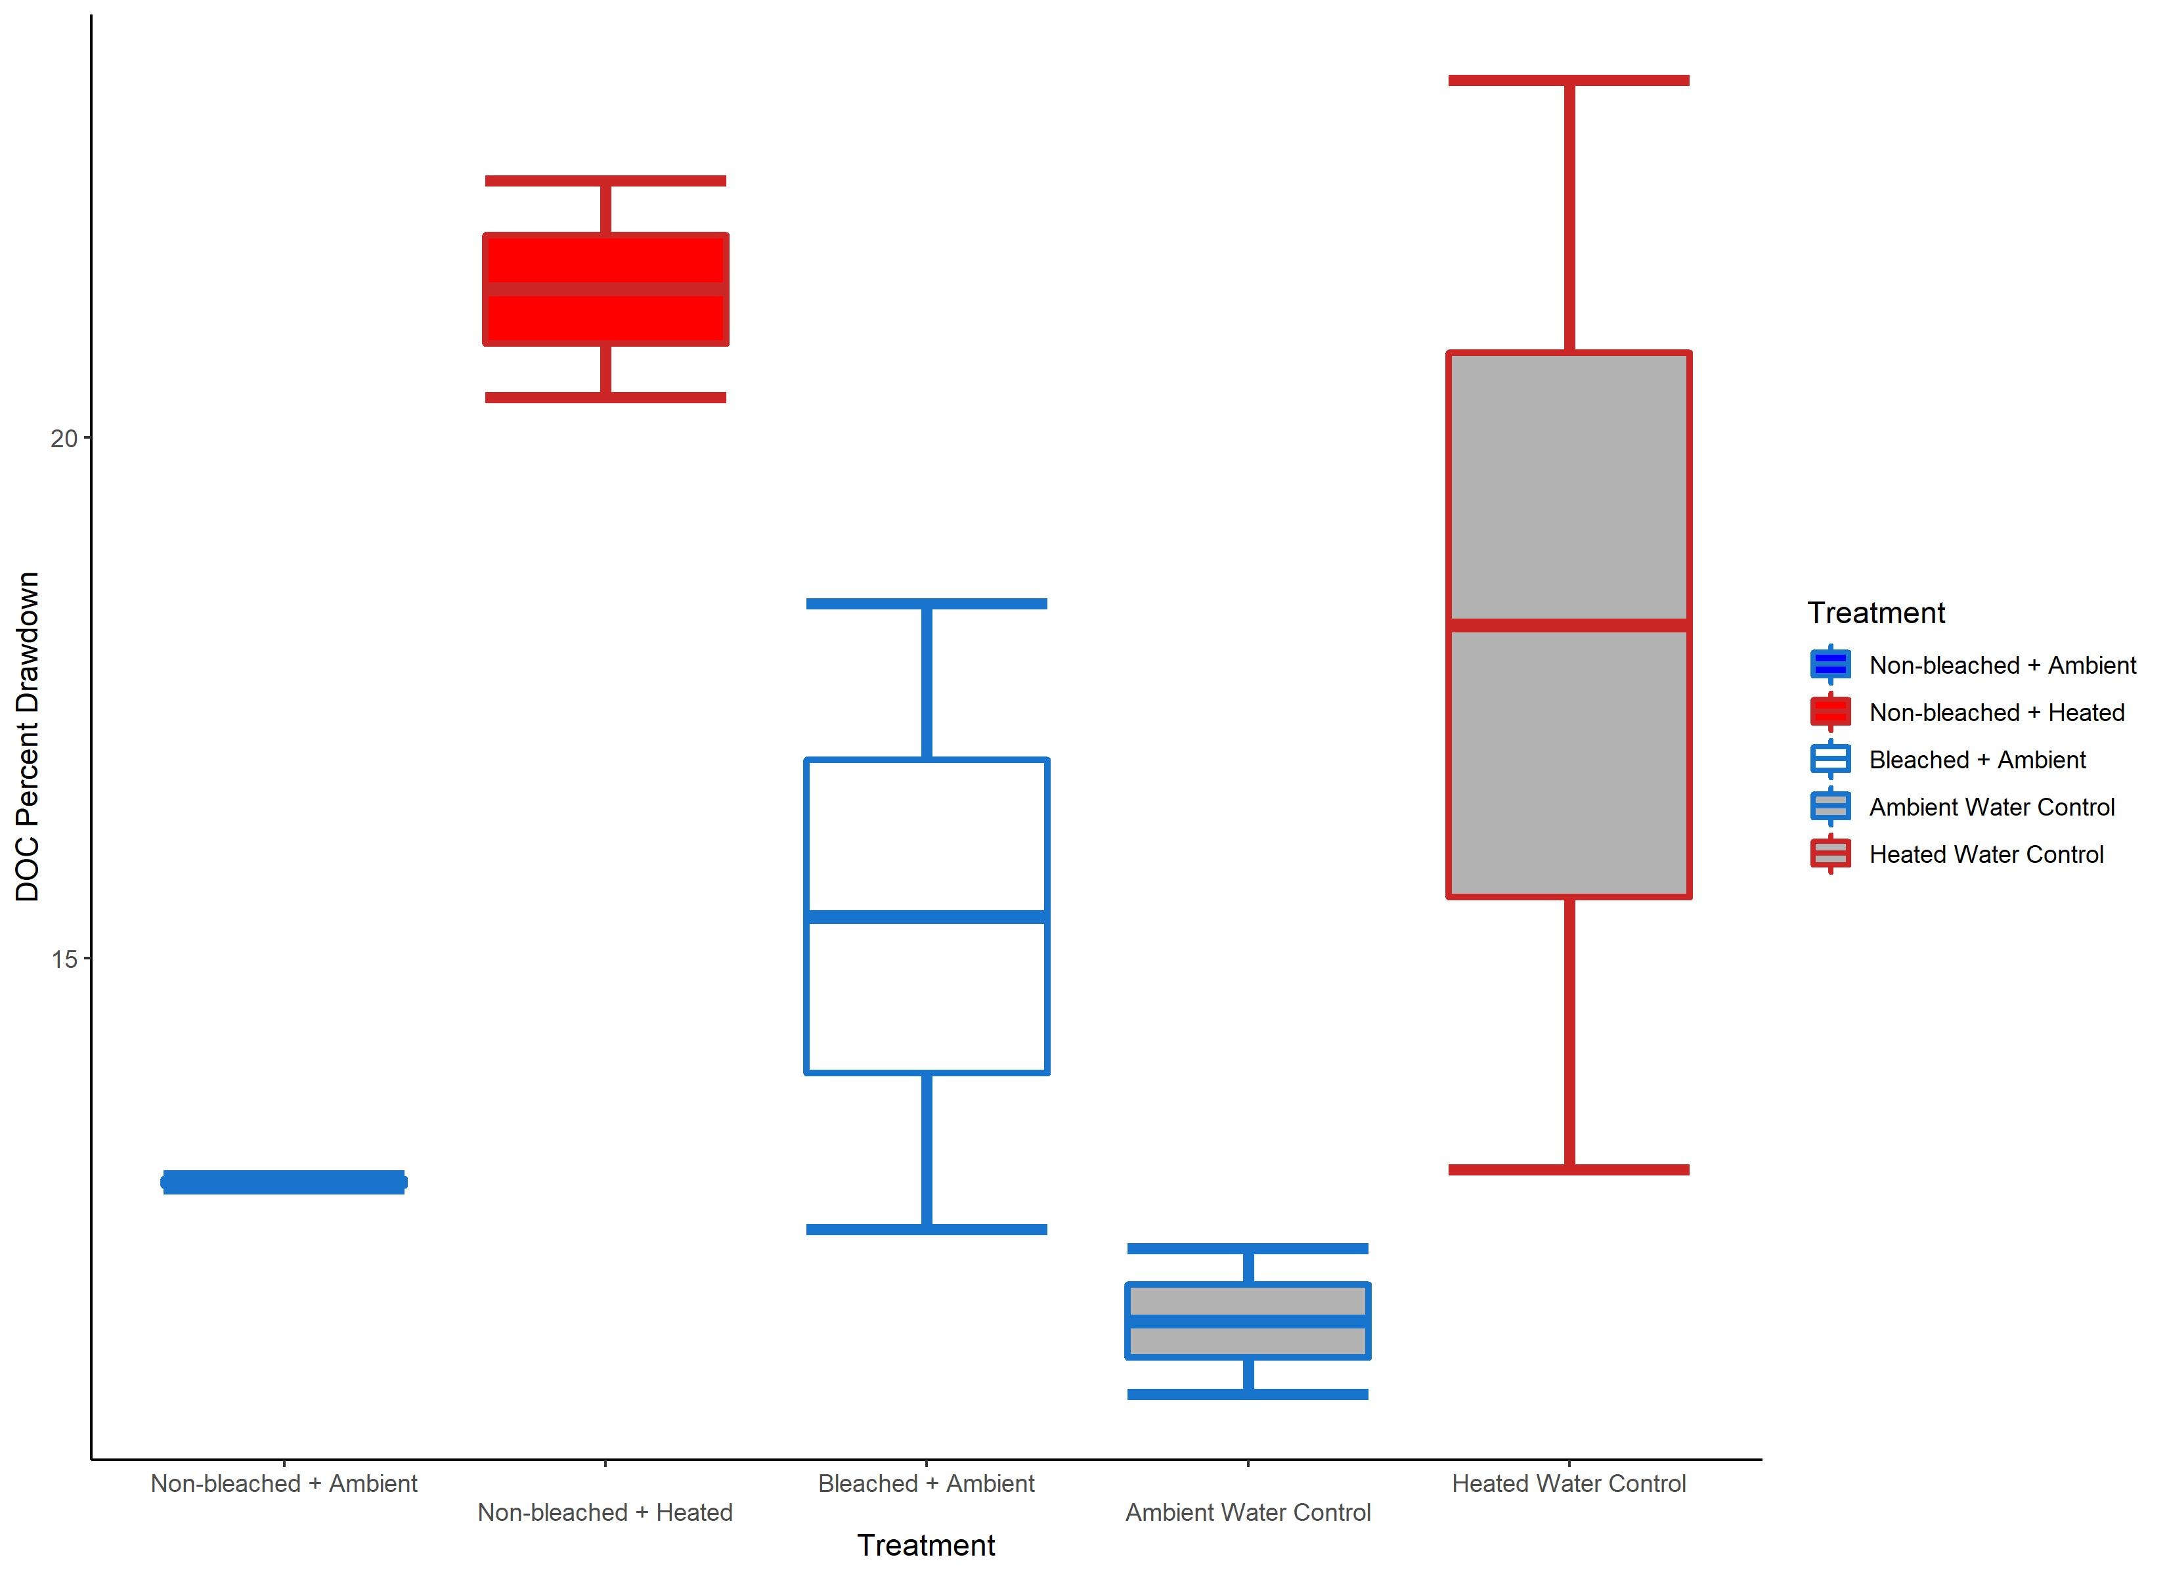
Figure S10: Box and whisker plots of the DOC drawdown (%) for ech treatment. “Bleached + Heated” is excluded due to loss of samples from DOC contamination.

